Slide 1
THE THEORY OF EVERYTHING + (so far)
Presentation to the
Mohawk Valley Astronomical Society
Peter J. Costianes
Physicist
Air Force Research Laboratory, Retired

Slide 2
OUTLINE
1. Quantum Fields
The Standard Model
Higgs Boson
The Electromagnetic Field/The Photon
Strong Nuclear Force/Gluon
Weak Nuclear Force Field/Z and W Bosons
2. Space-Time /Gravitational Waves
3. The Theory of Everything
4. Quantum Field Theory
5. Dark Matter and Dark Energy
6. The Multiverse
7. String Theory

Slide 3
The Matter Field

Slide 4
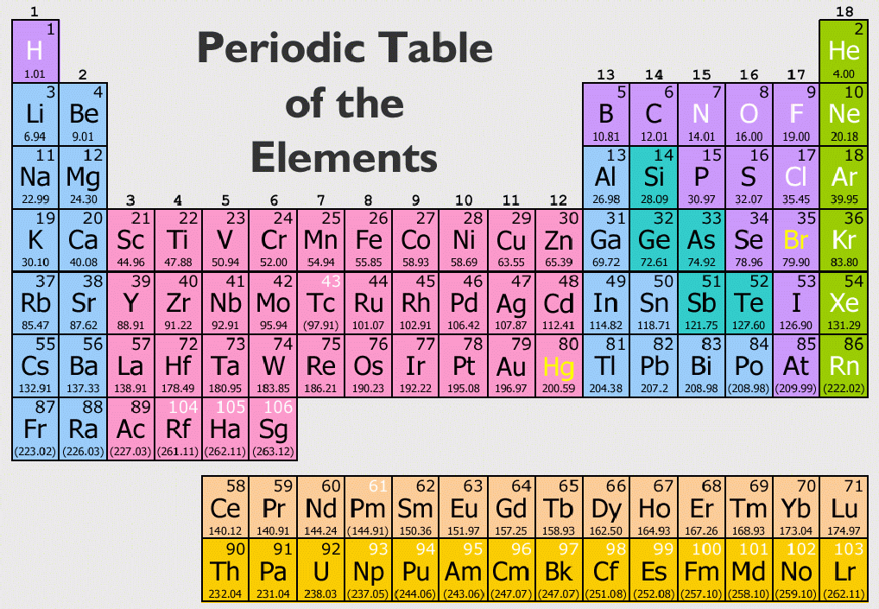

Slide 5
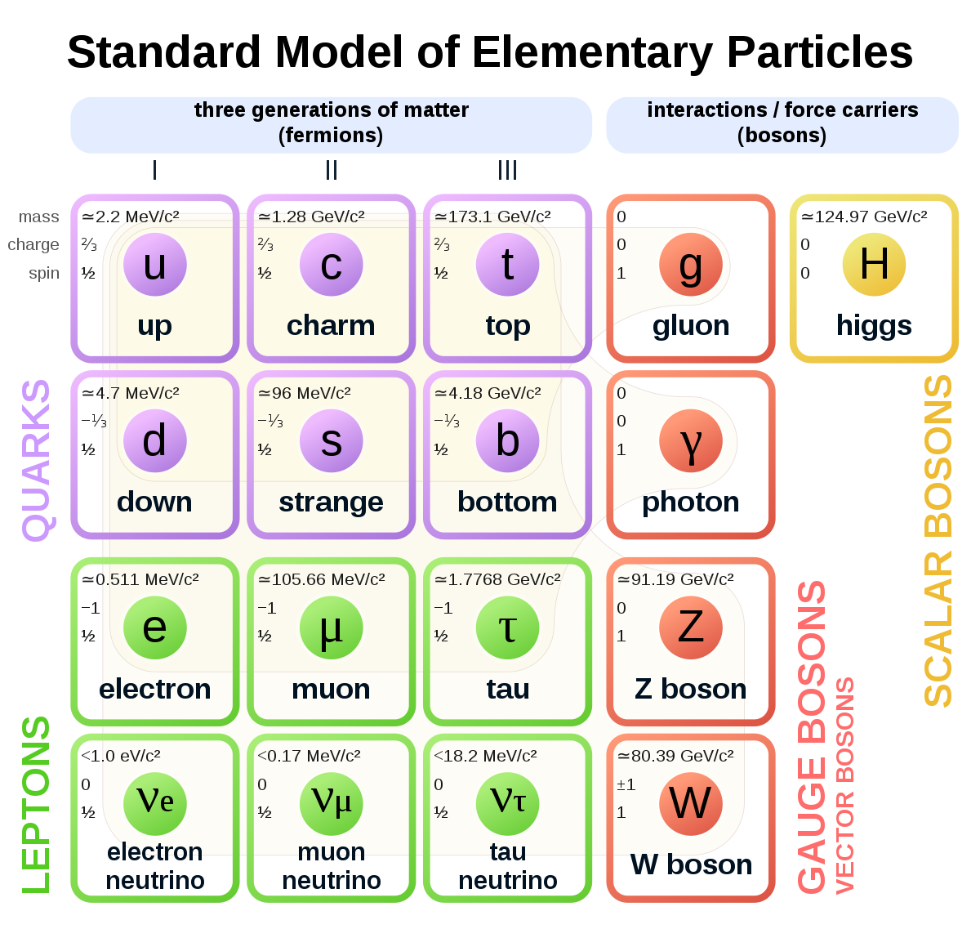

Slide 6
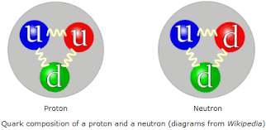
The Proton and Neutron

Slide 7
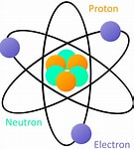
The Rutherford Atom

Slide 8
Higgs field
scalar field and via the Higgs mechanism gives mass to many particles of matter.

Slide 9
Electromagnetic Field

Slide 10
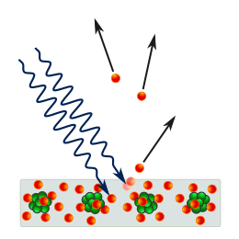
THE PHOTOELECTRIC EFFECT
Light Energy Photons
Electrons ejected
Matter

Slide 11
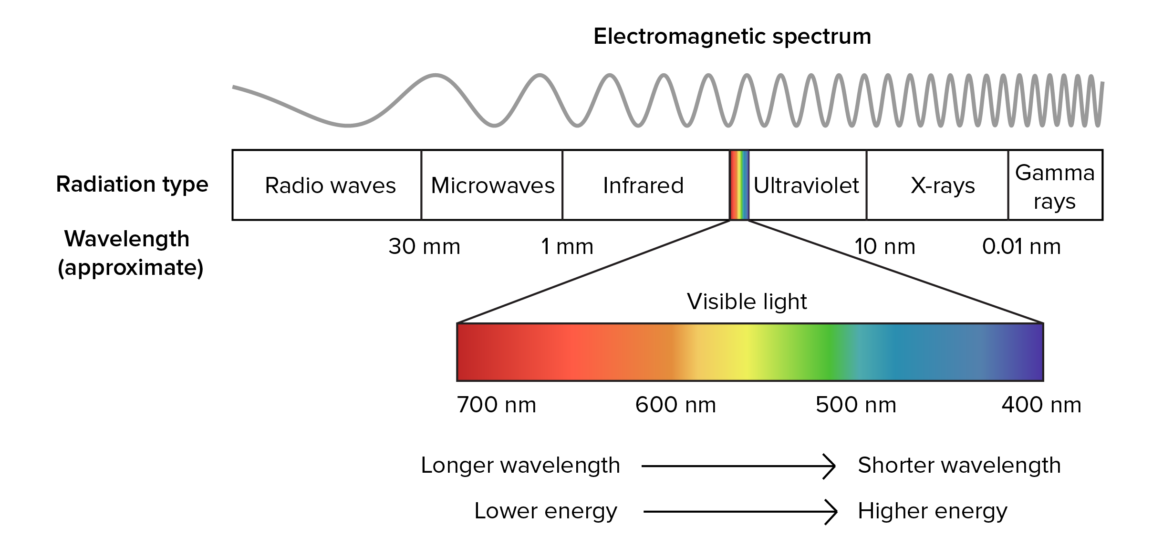
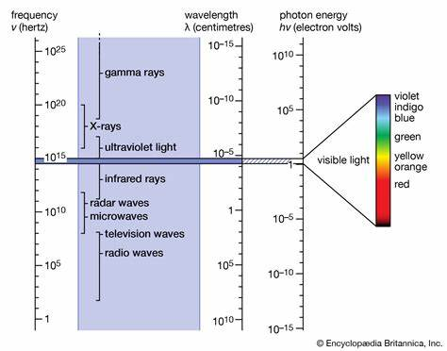
Electromagnetic Spectrum

Slide 12
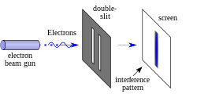
Photons or particles of matter (like an electron) produce a
wave pattern when two slits are used
Light from a green laser passing through two slits
0.4mm wide and 0.1mm apart

Slide 13
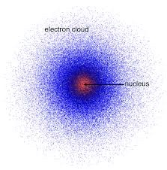
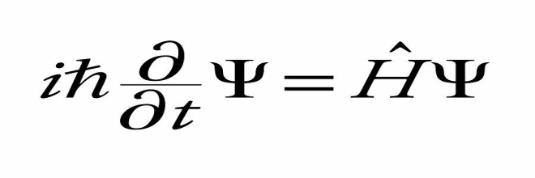
Electron Cloud Model Quantum Mechanics
Atom
Schrodinger Wave Equation

Slide 14
STRONG NUCLEAR FORCE FIELD
A force between elementary or subatomic particles that holds quarks together to form protons and neutrons, and also binds protons and neutrons together in the atomic nucleus

Slide 15
wEAK NUCLEAR FORCE Field
It is the mechanism of interaction between subatomic particles that is responsible for the radioactive decay of atoms: The weak interaction participates in nuclear fission and nuclear fusion.

Slide 16
Space – Time
GENERAL RELATIVITY
The fabric of space-time is a conceptual model combining the three dimensions of space with the fourth dimension of time. According to the best of current physical theories, space-time explains the unusual relativistic effects that arise from traveling near the speed of light as well as the motion of massive objects in the universe.

Slide 17
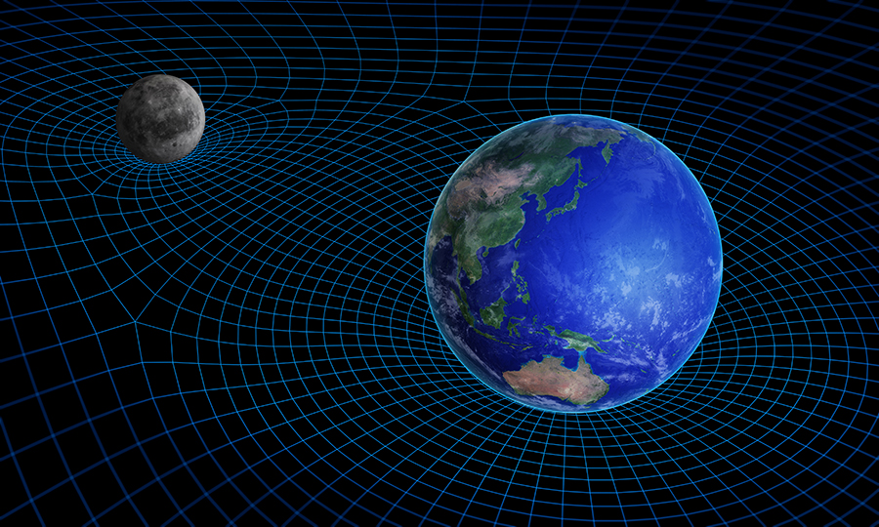
Mass curves space-time

Slide 18
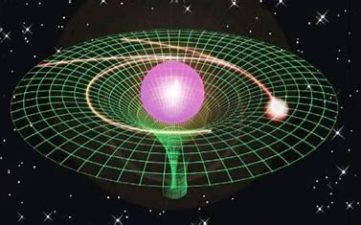
Mass and energy (light) follow the curvature of space-time

Slide 19
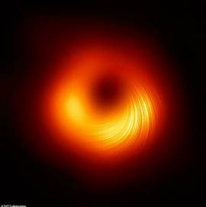
Supermassive Black Hole in M87
Event Horizon Telescope

Slide 20
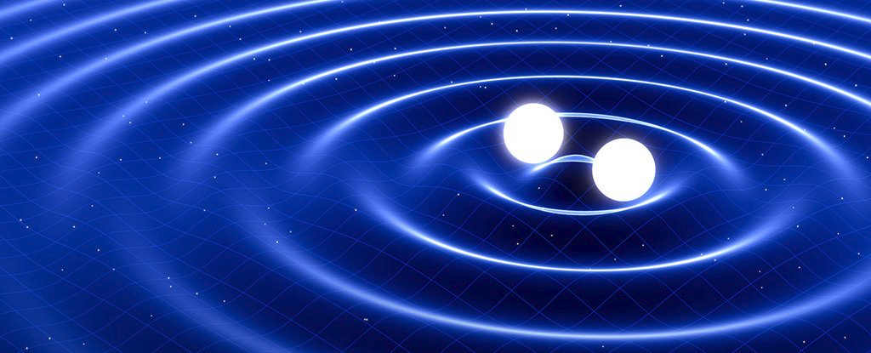
Gravitational Waves produced by a Binary System

Slide 21
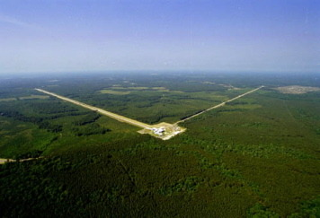
Laser Interferometer Gravitational-wave Observatory
(LIGO)

Slide 22
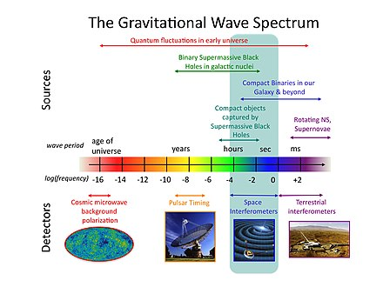

Slide 23
Quantum Field Theory
In theoretical physics, quantum field theory (QFT) is a theoretical framework that combines classical field theory, special relativity, and quantum mechanics.^{[1]: xi} QFT is used in particle physics to construct physical models of subatomic particles
QFT treats particles as excited states (also called quanta) of their underlying quantum fields, which are more fundamental than the particles.

Slide 24
Quantum Field Theory
Click the link below to view the video on Youtube.
Quantum Field Theory – An Introduction

Slide 25
Dark Matter
&
DARK ENERGY

Slide 27
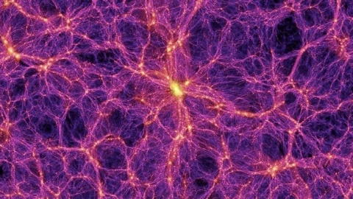
The Cosmic Web

Slide 28
The Big Bang video
Click the link below to view the video on Youtube
The Beginning of Everything – The Big Bang

Slide 29
Click the link below to view the Quantum Gravity Video on Youtube
Why do we need Quantum Gravity to Explain the Big Bang?

Slide 30
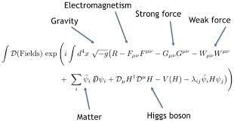
Equation for the Theory of Everything
Z =

Slide 31
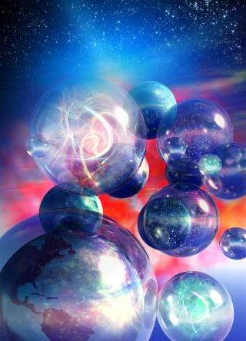
Multiple
Universes

Slide 32
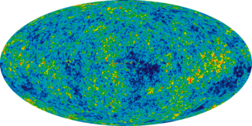
Cosmic Microwave Background
The Fireball of the Big Bang
Notes:
electromagnetic radiation which is a remnant from an early stage of the universe, also known as "relic radiation"^{[citation needed]}. The CMB is faint cosmic background radiation filling all space. It is an important source of data on the early universe because it is the oldest electromagnetic radiation in the universe, dating to the epoch of recombination.

Slide 33
Click the link below to view the video on Youtube
Do we live in a Multiverse

Slide 34
STRING THEORY
Theoretical framework in which the point-like particles of particle physics are replaced by one-dimensional objects called strings. String theory describes how these strings propagate through space and interact with each other. On distance scales larger than the string scale, a string looks just like an ordinary particle,with its mass, charge, and other properties determined by the vibrational state of the string. In string theory, one of the many vibrational states of the string corresponds to the graviton, a quantum mechanical particle that carries the gravitational force. Thus, string theory is a theory of quantum gravity.

Slide 35
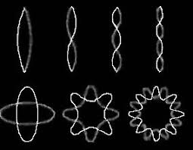
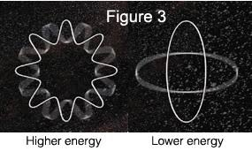
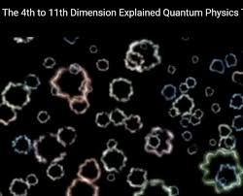
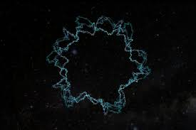
One notable feature of string theory is that it requires 11 dimensions
of space-time to provide mathematical consistency.

Slide 36
Questions and Discussion
Peter J. Costianes
8520 Elmer Hill Road
Rome, NY 13440
315-337-1409
petercostianes@gmail.com

