Slide 1
Weather and Astronomy
WKTV Chief Meteorologist Bill Kardas

Slide 2
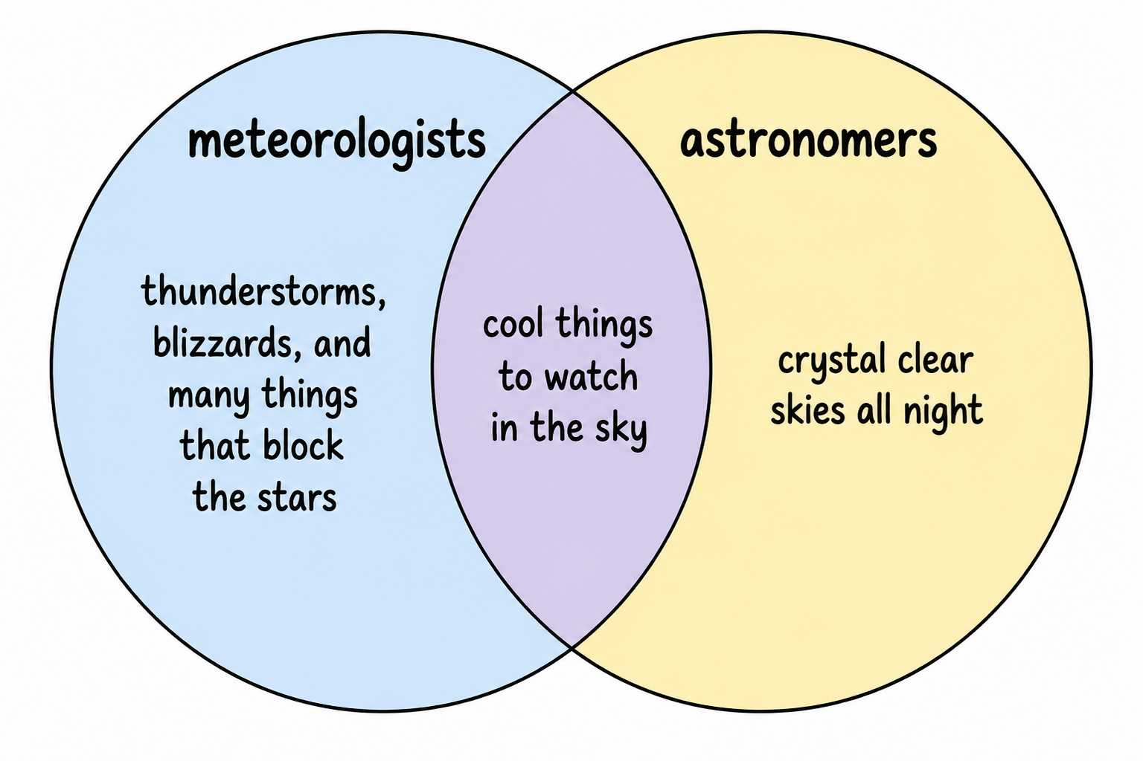
Tonight's Venn Diagram

Slide 3
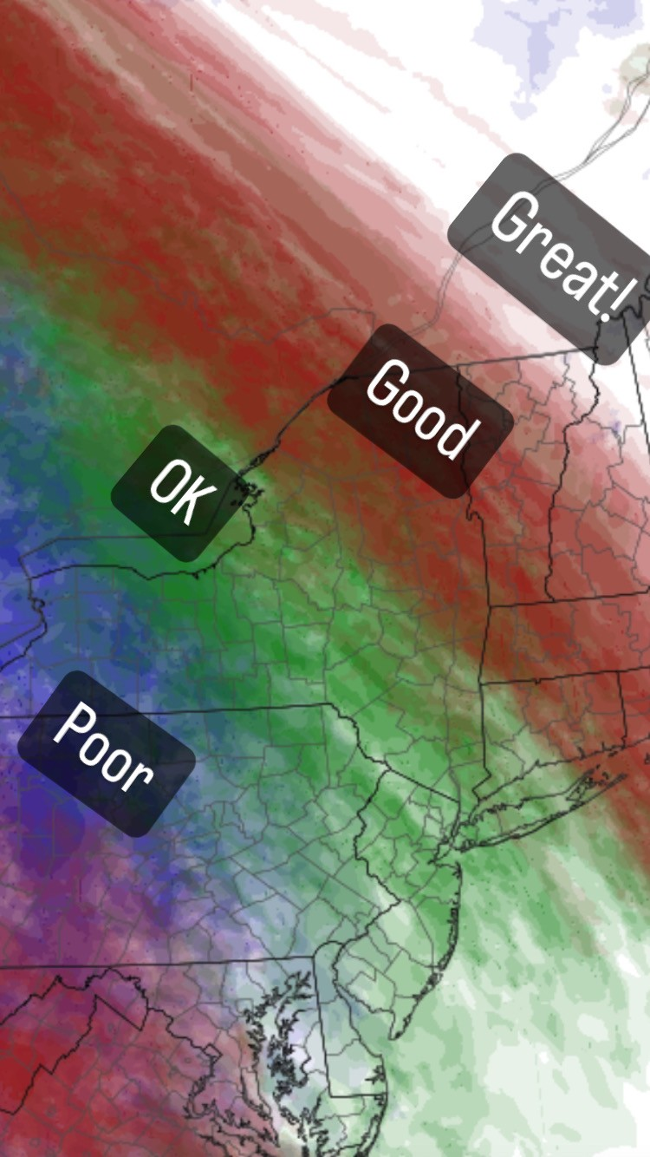
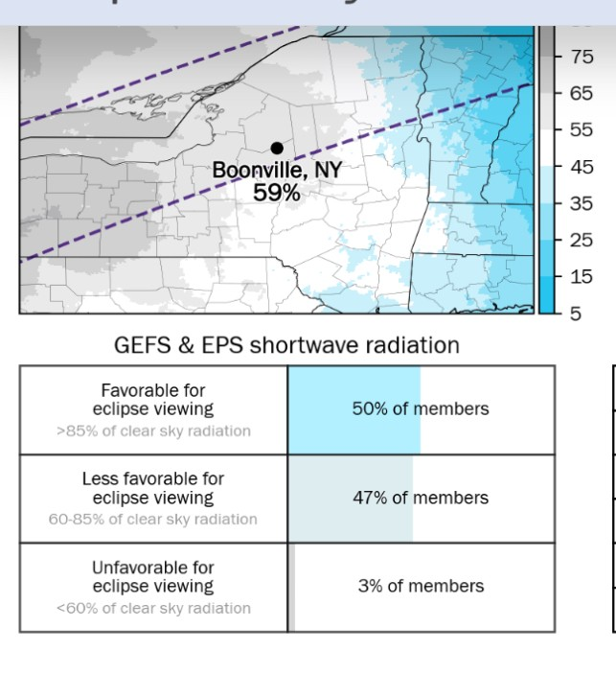
Total Solar Eclipse

Slide 4
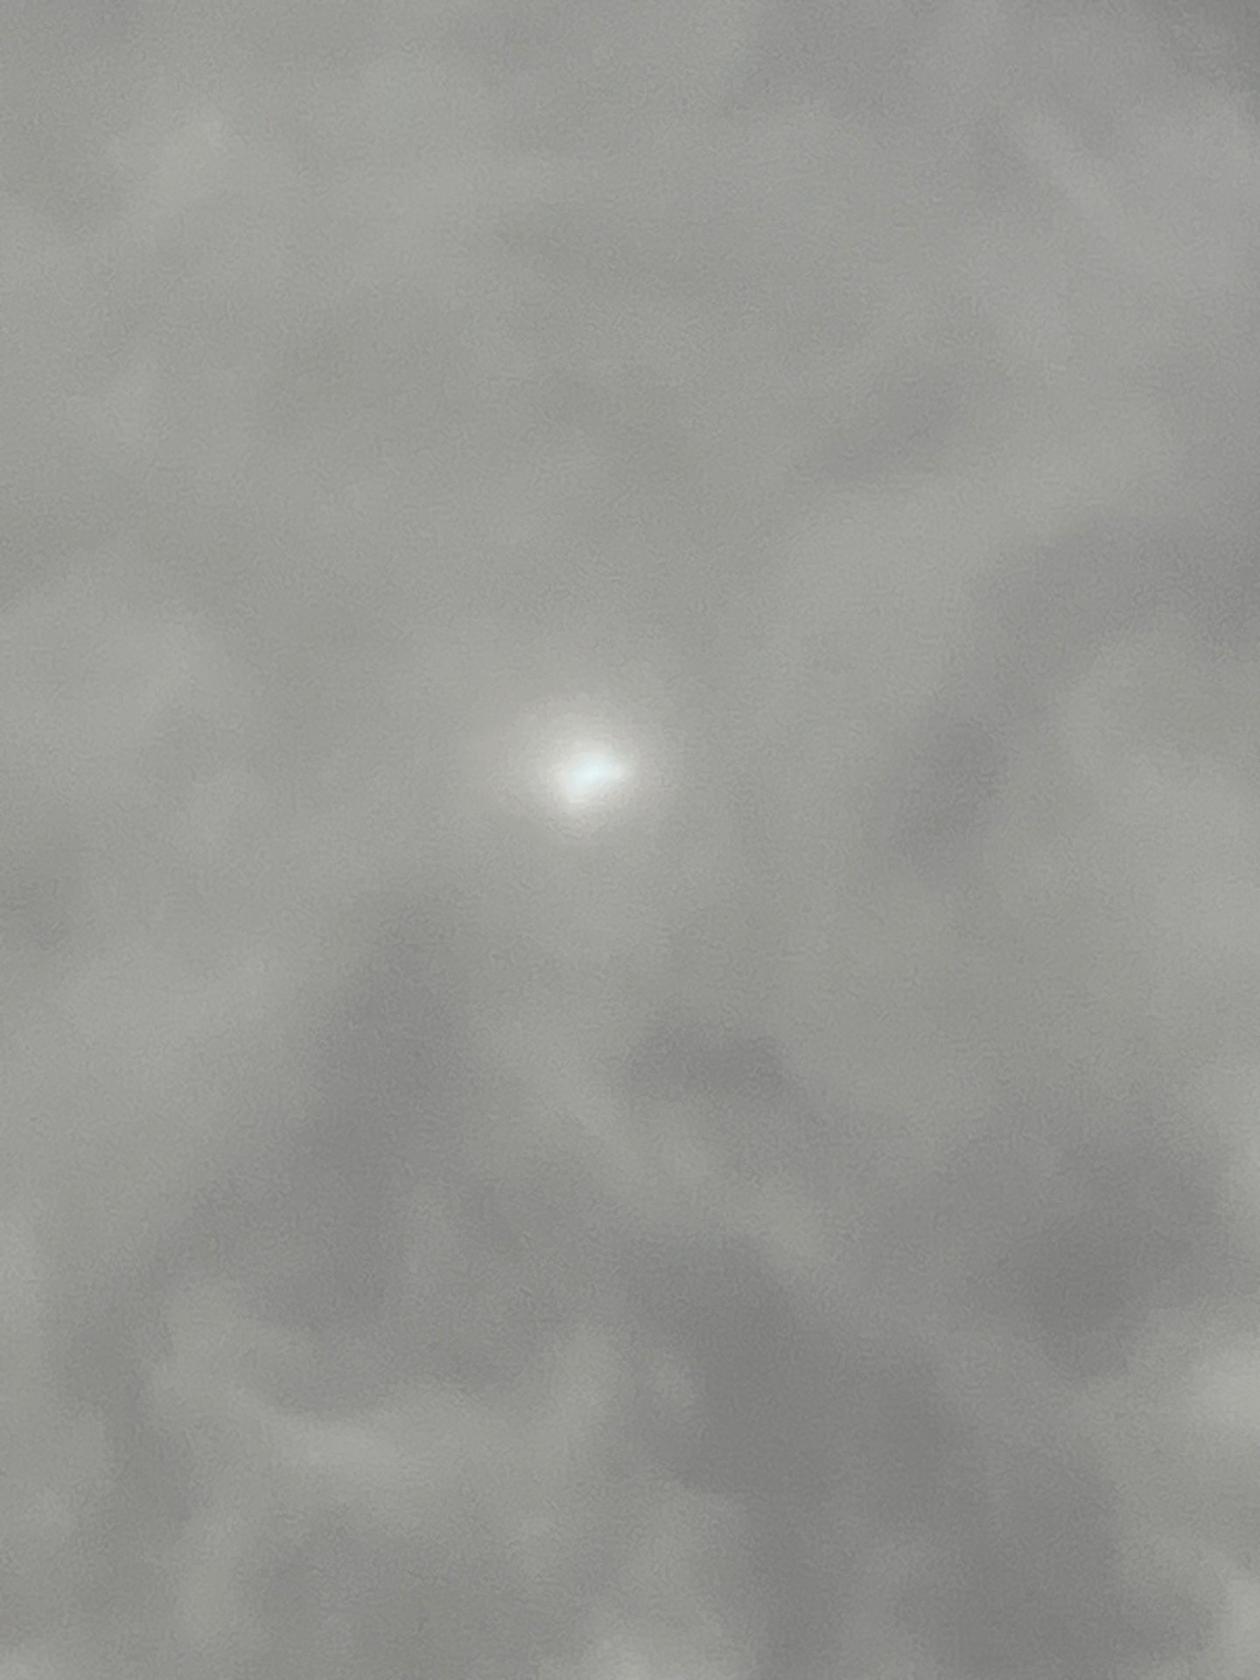
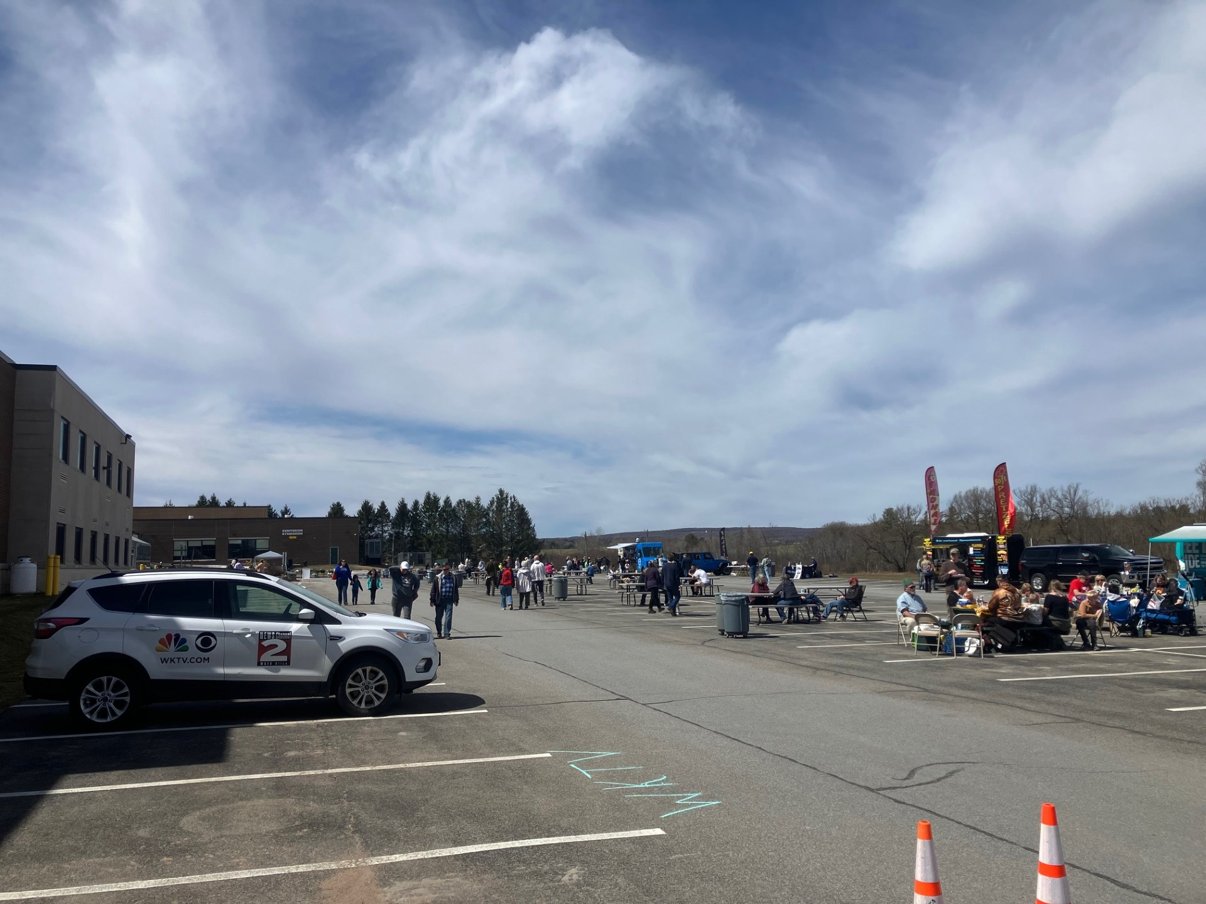
My View of the Total Solar Eclipse

Slide 5
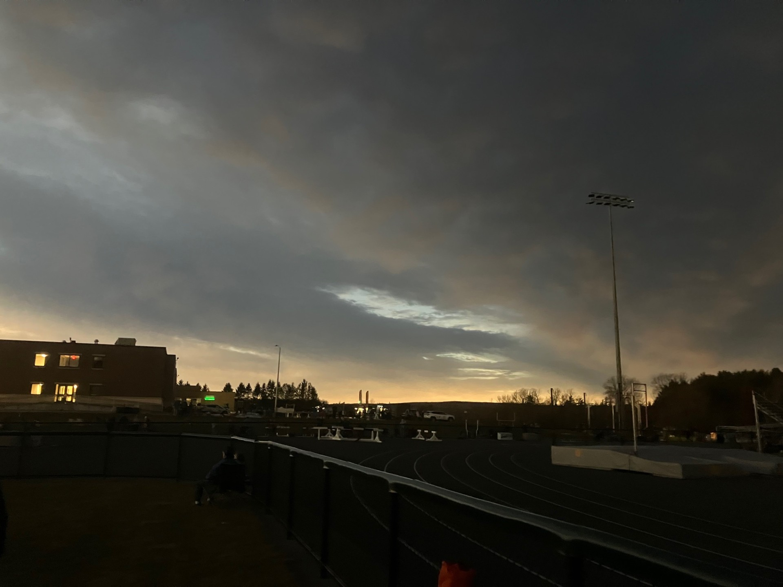
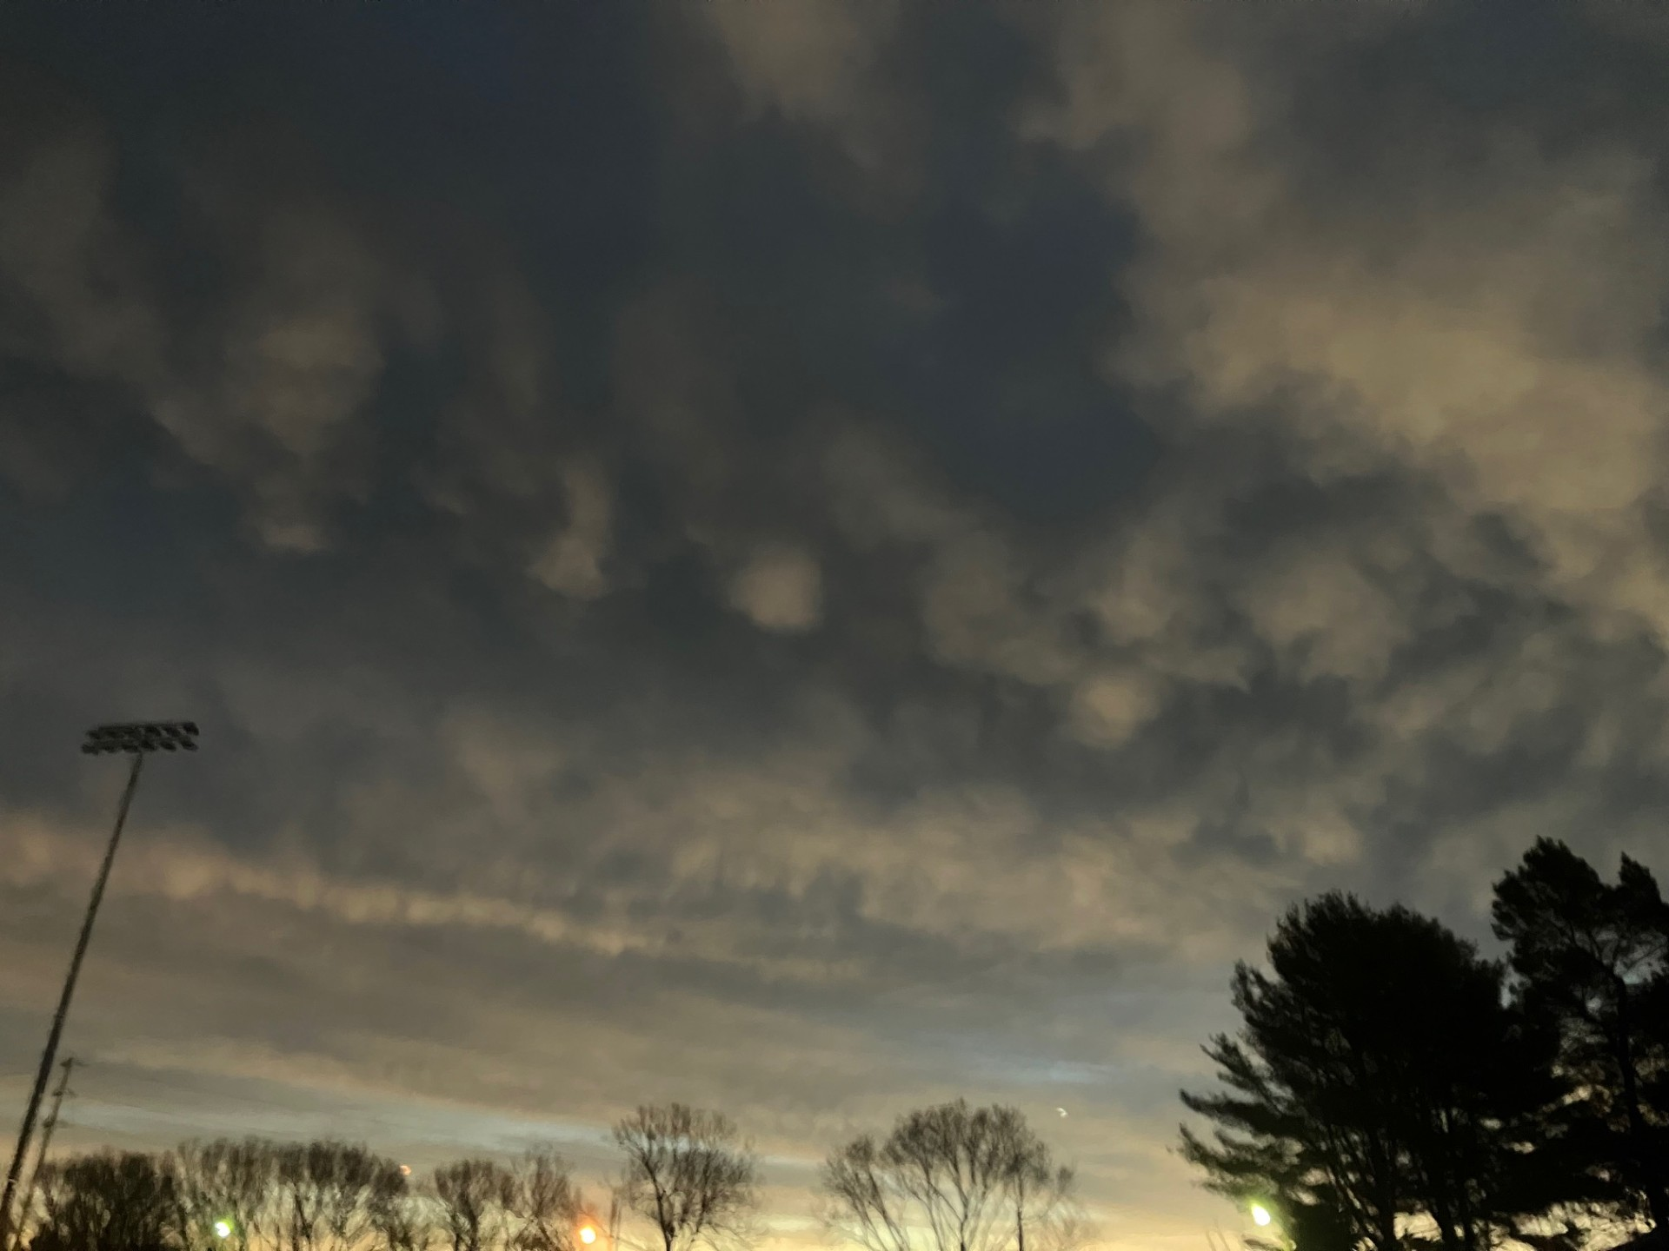
My View of the Total Solar Eclipse

Slide 6
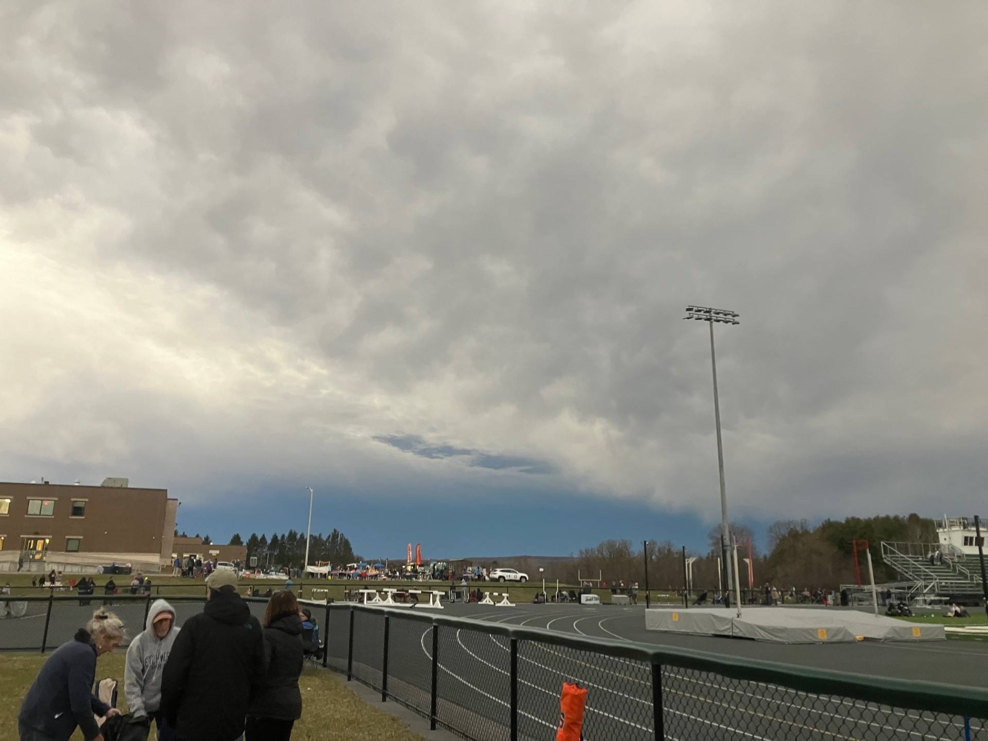
My View of the Total Solar Eclipse

Slide 7
Lessons Learned
Despite the science, there's still an element of luck involved
Things don't always work out as planned
Some unique experiences can be found

Slide 8
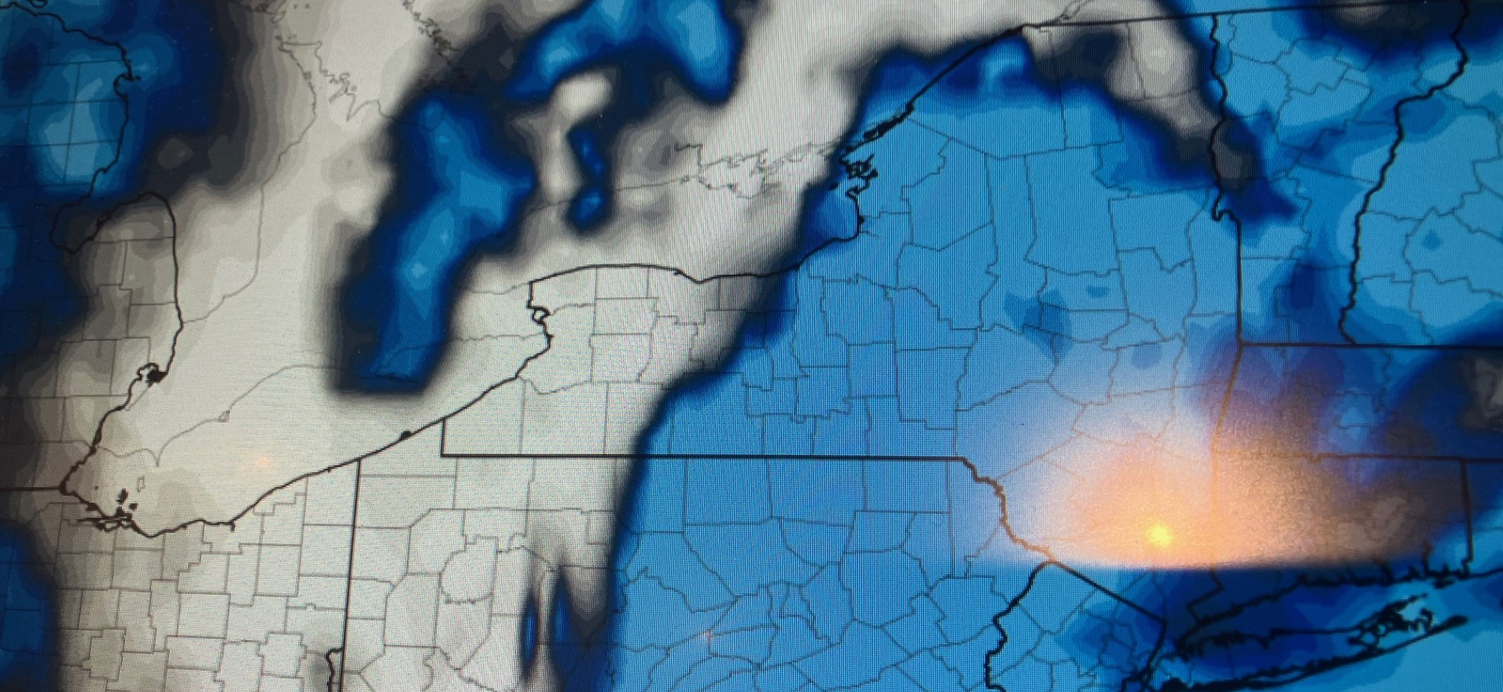
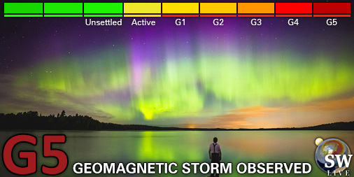
May 11th, 2024 - G5 AND CLOUDY!!!

Slide 9
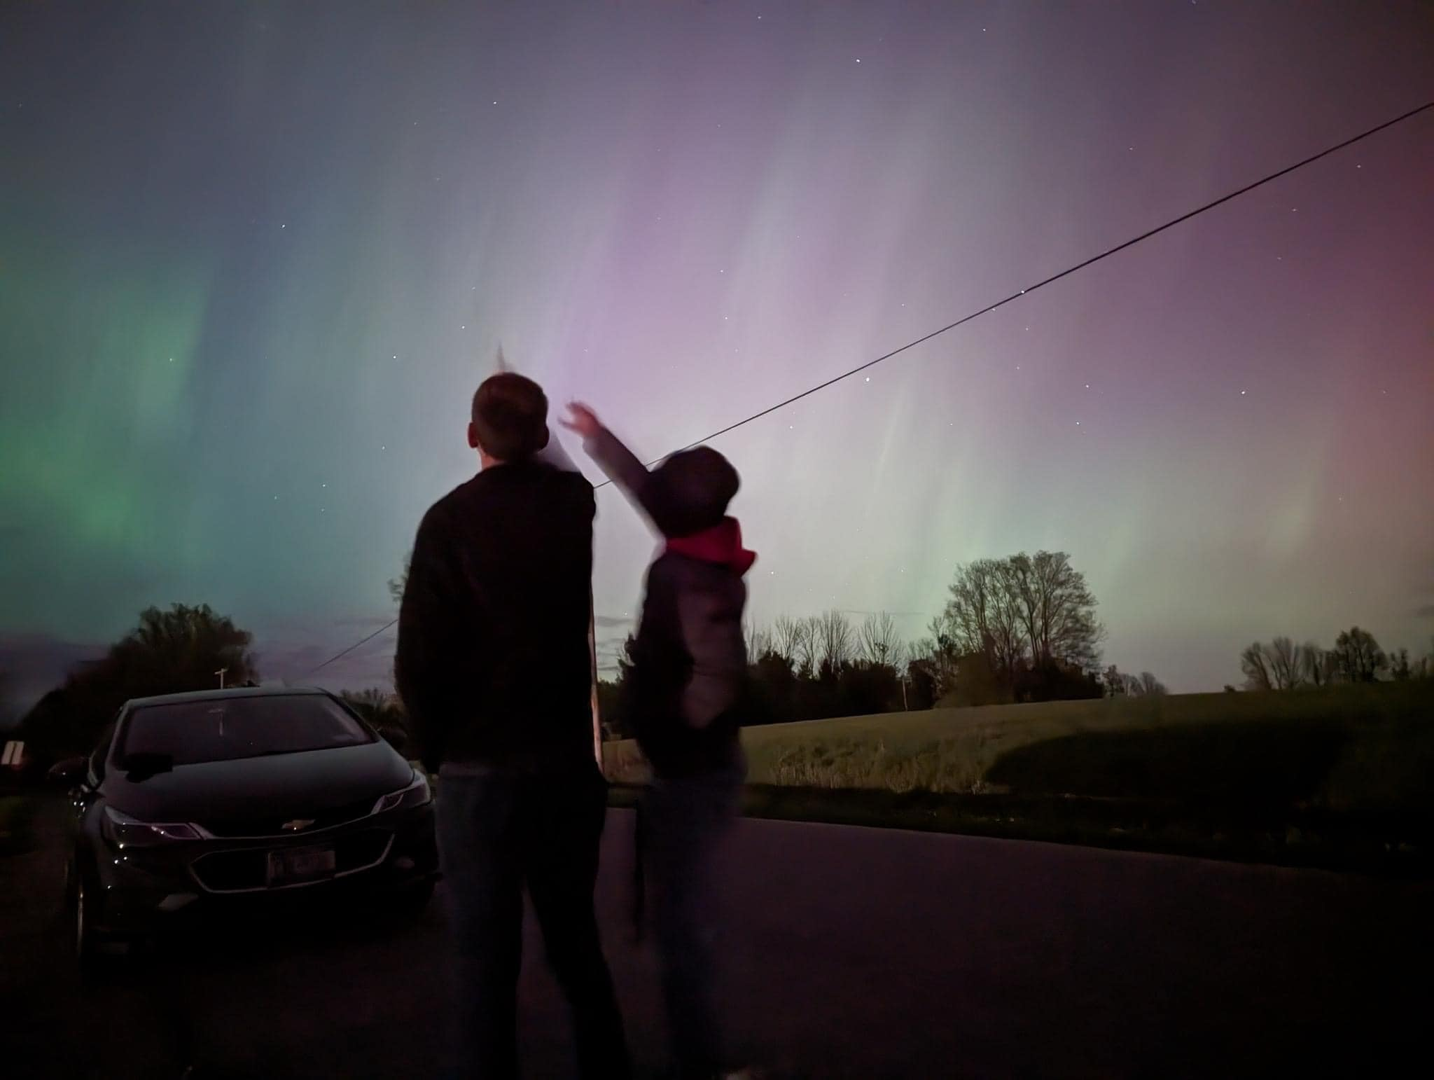

Slide 10
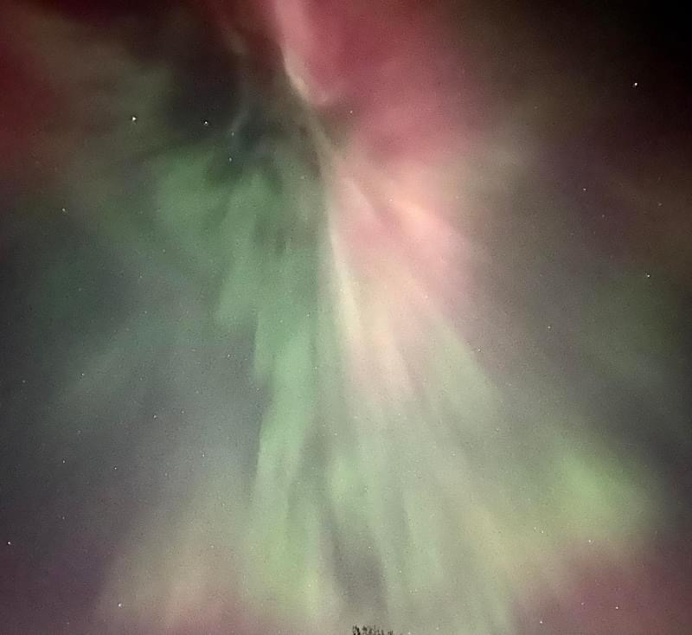
Northern Lights – My Journey of Discovery
May 11th, 2024

Slide 11
Lessons Learned
Still need luck!
Be willing to change course and follow new data
I need a better camera

Slide 12
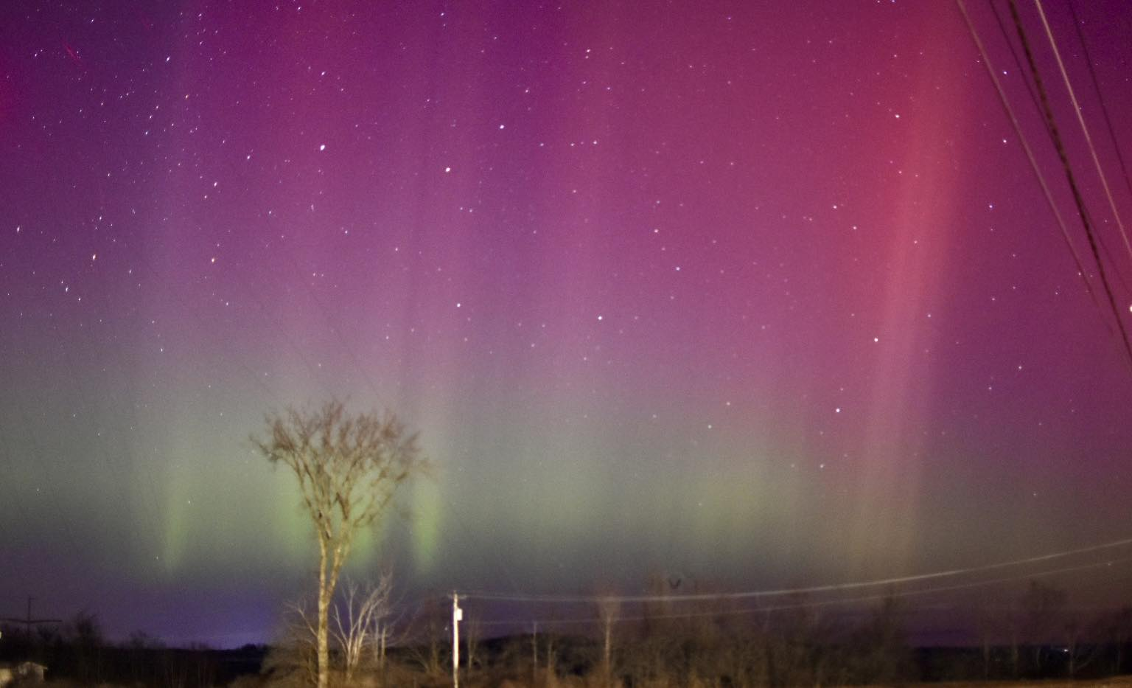
Northern Lights – My Journey of Discovery
March 21st, 2025

Slide 13
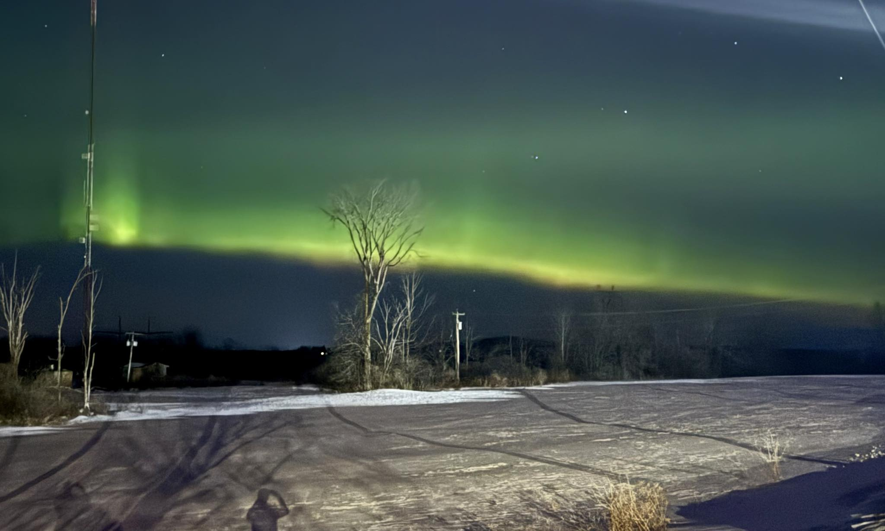
Northern Lights – My Journey of Discovery
January 20th, 2026

Slide 14
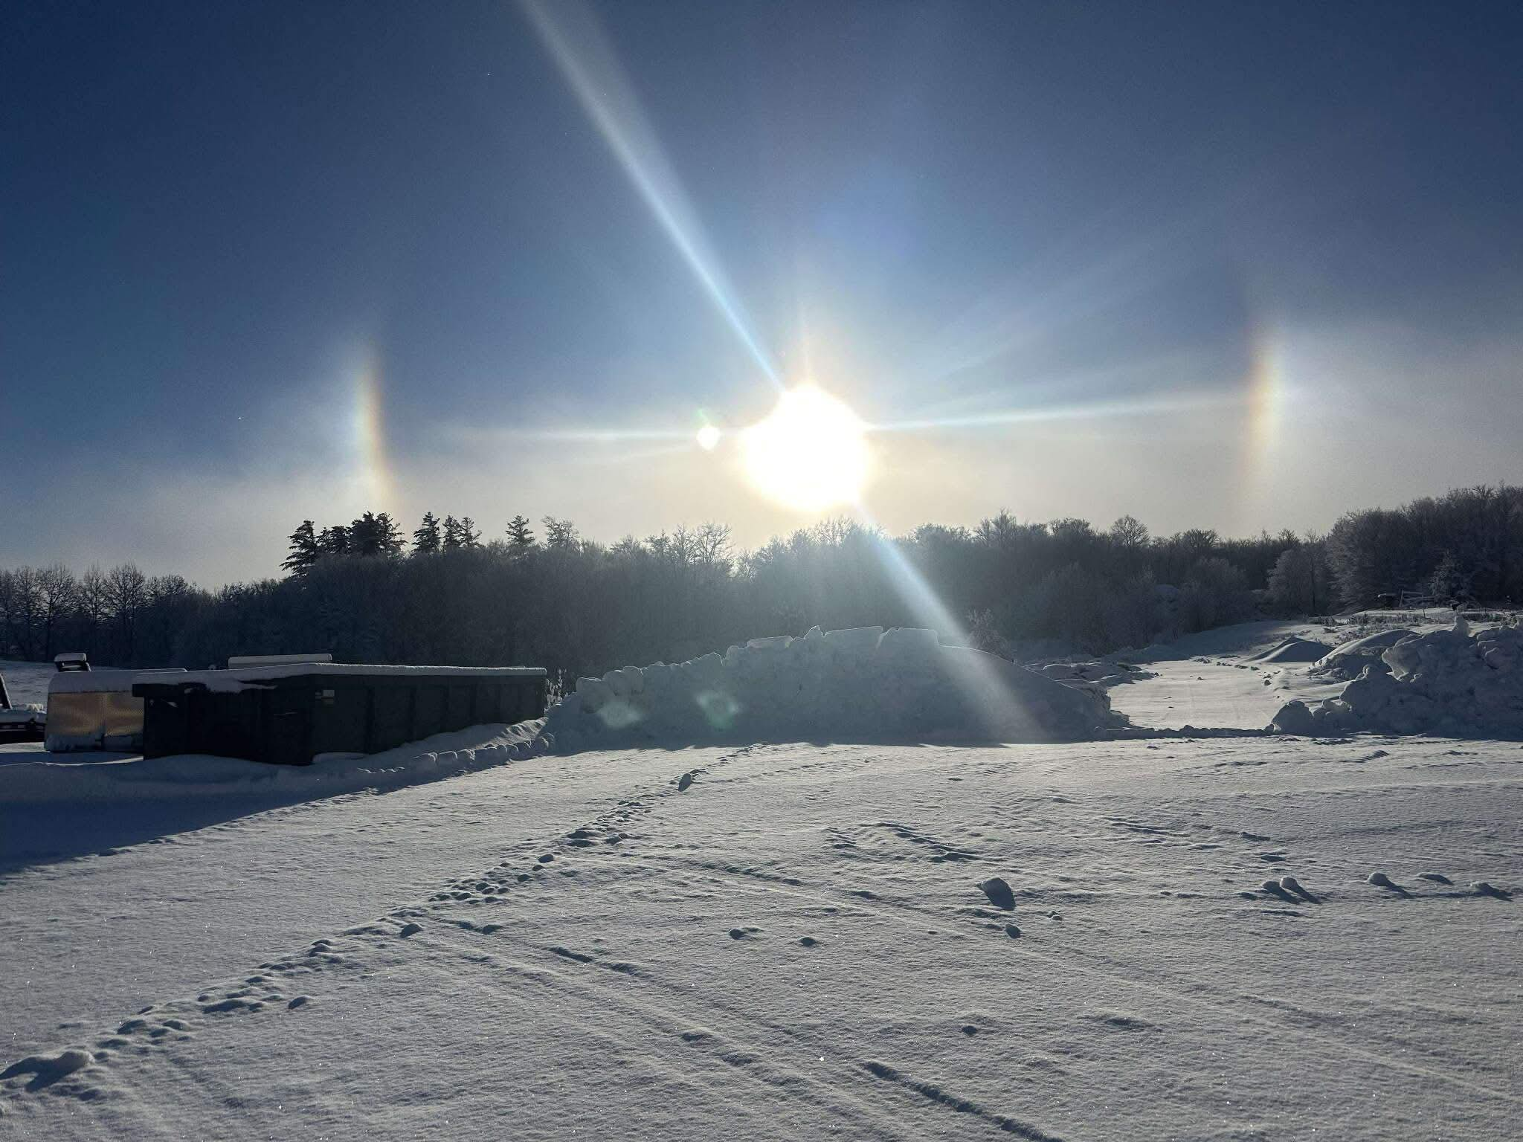
Atmospheric Optics – Sun Dog
Sunlight refraction of hexagonal ice crystals
Kyle O'Connor
1/16/26

Slide 15
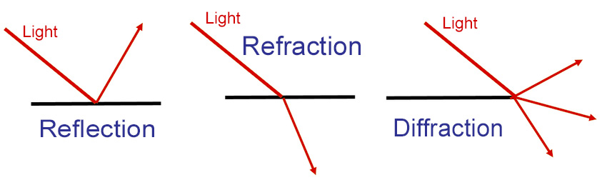
Refraction, Reflection, Diffraction

Slide 16
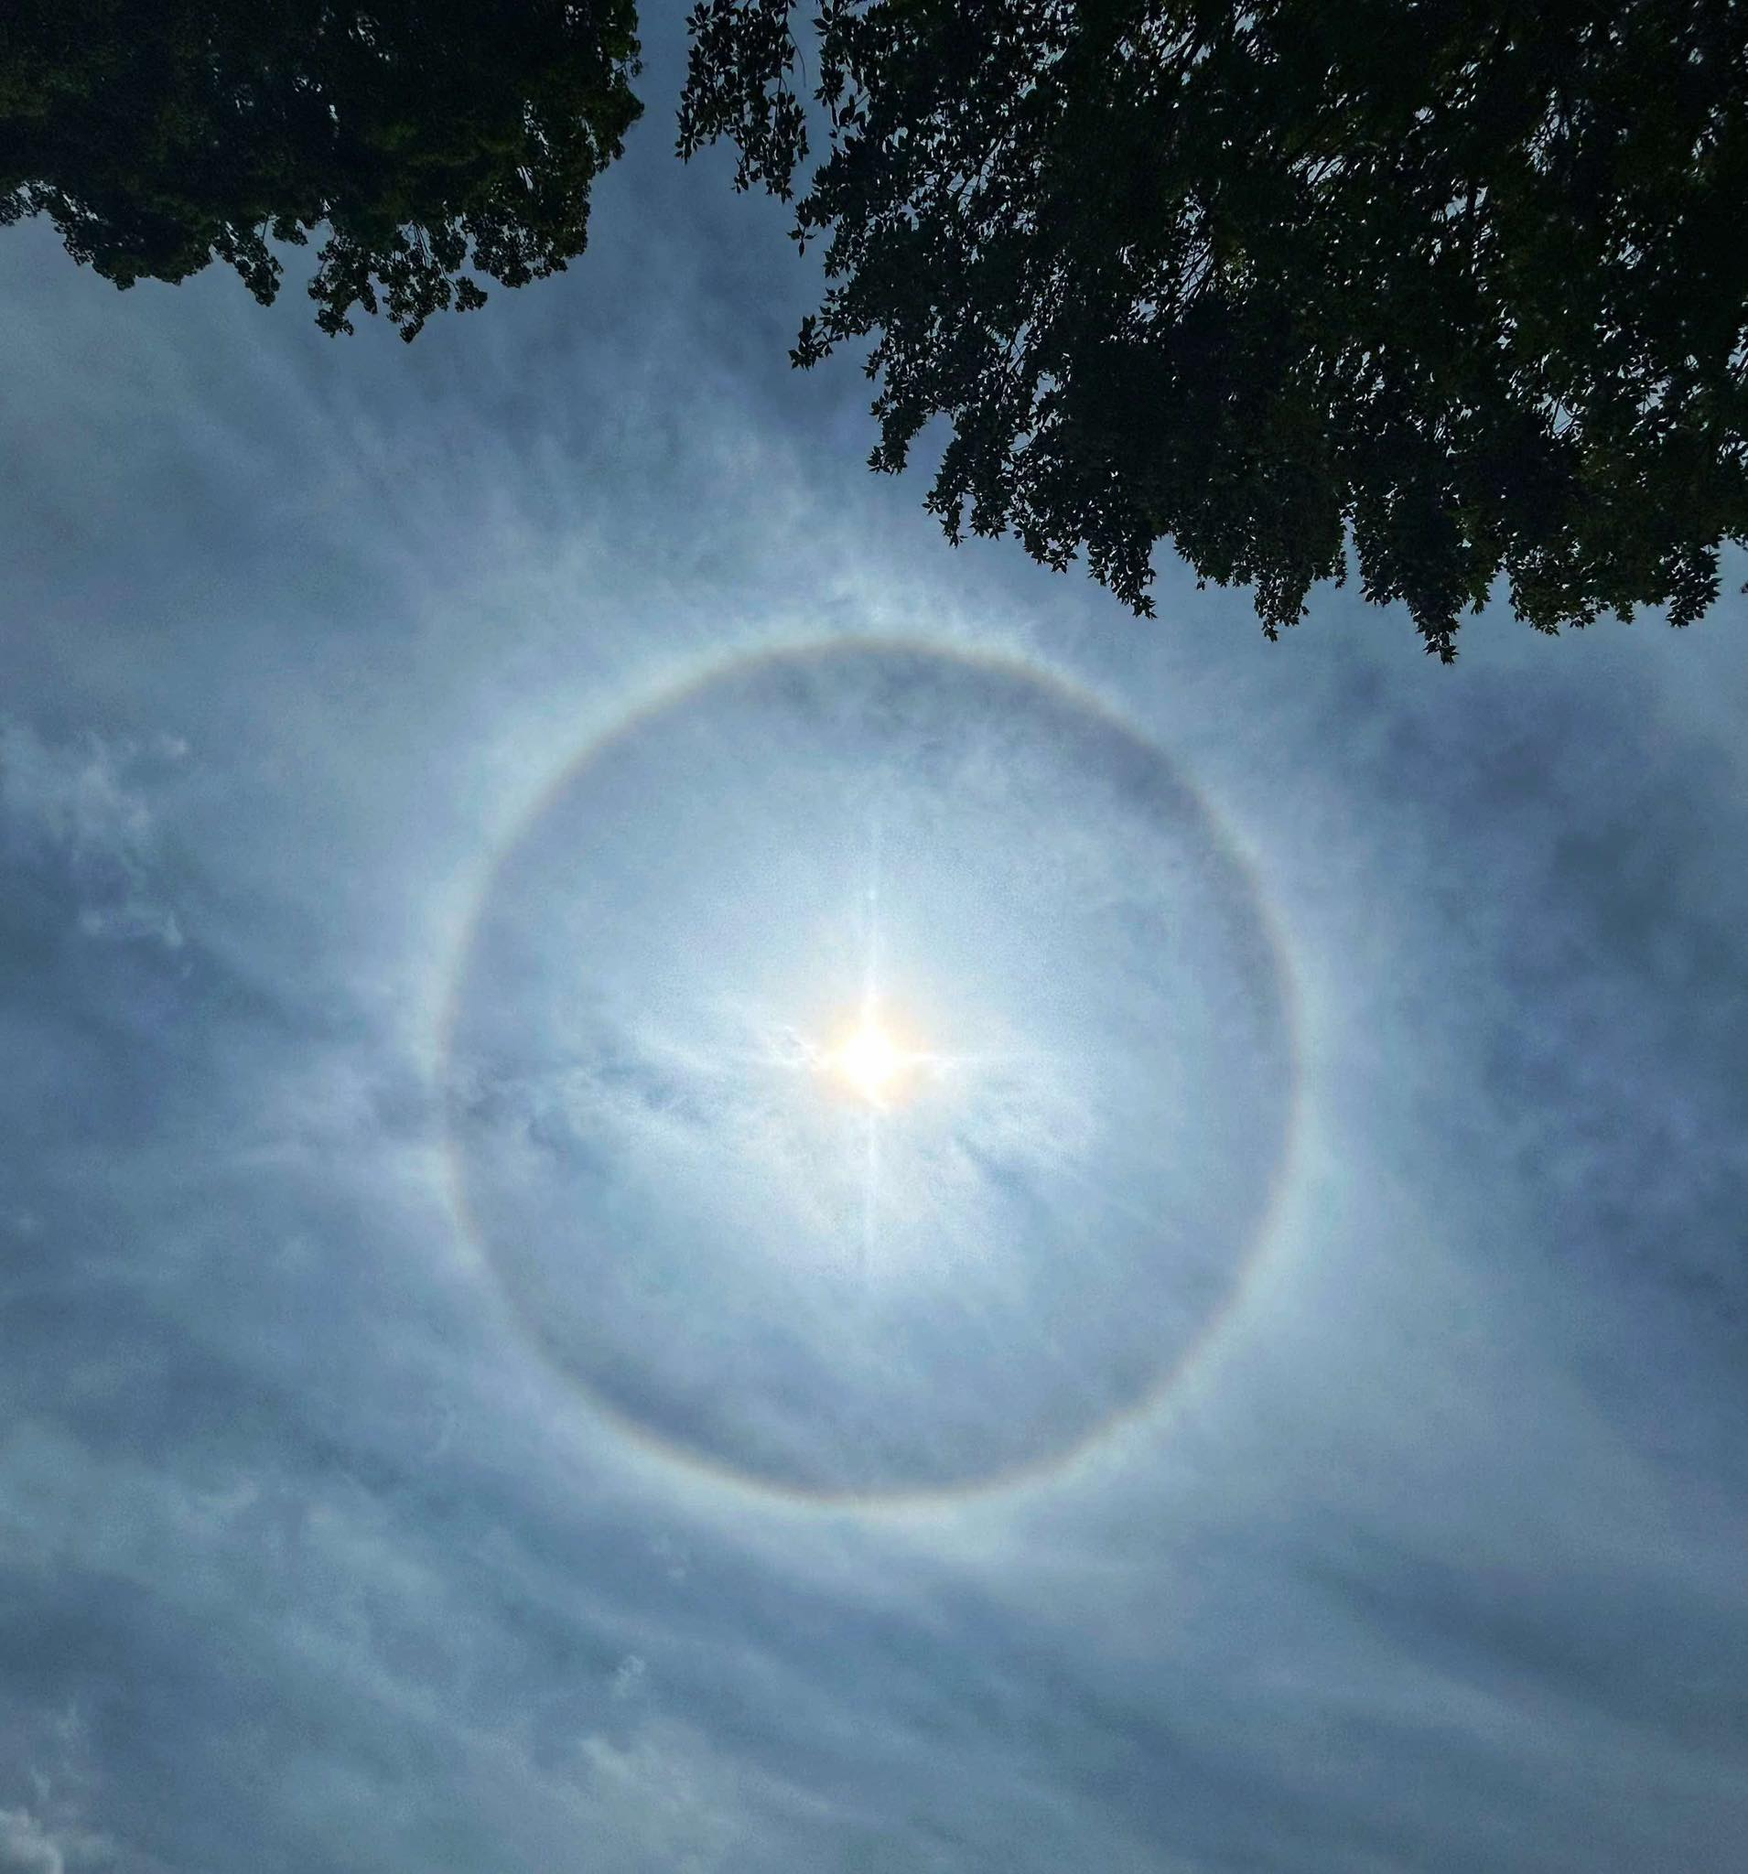
Atmospheric Optics – Halo
Similar to sun dog, but at a higher sun altitude
Lisa Garofalo Curtis
Rome, NY 7/26/25

Slide 17
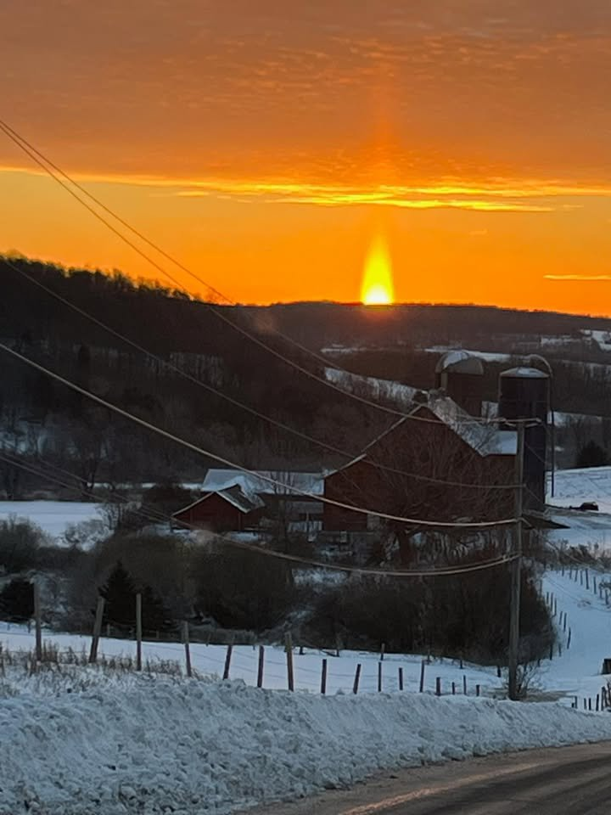
Atmospheric Optics – Sun Pillar
Reflection of ice crystals on hexagon shaped ice
Micky Michele Dziuban Litchfield
12/9/25

Slide 18
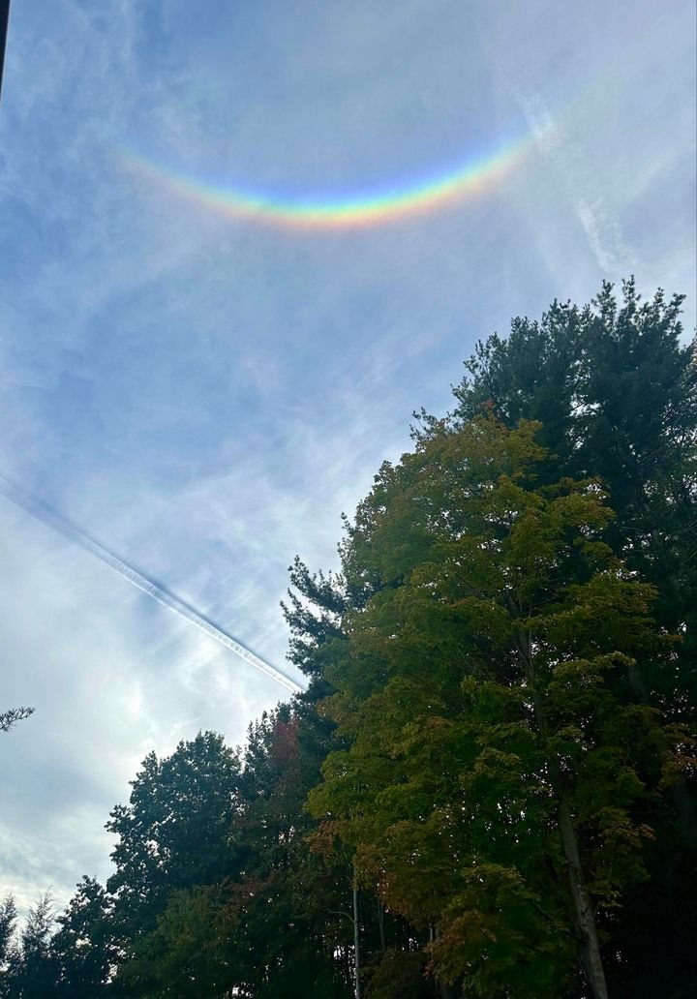
Atmospheric Optics – Circumzenithal Arc
Sunlight refraction of horizontal ice crystals at 46°
Jessica Gallison
New Hartford, NY
9/30/24

Slide 19
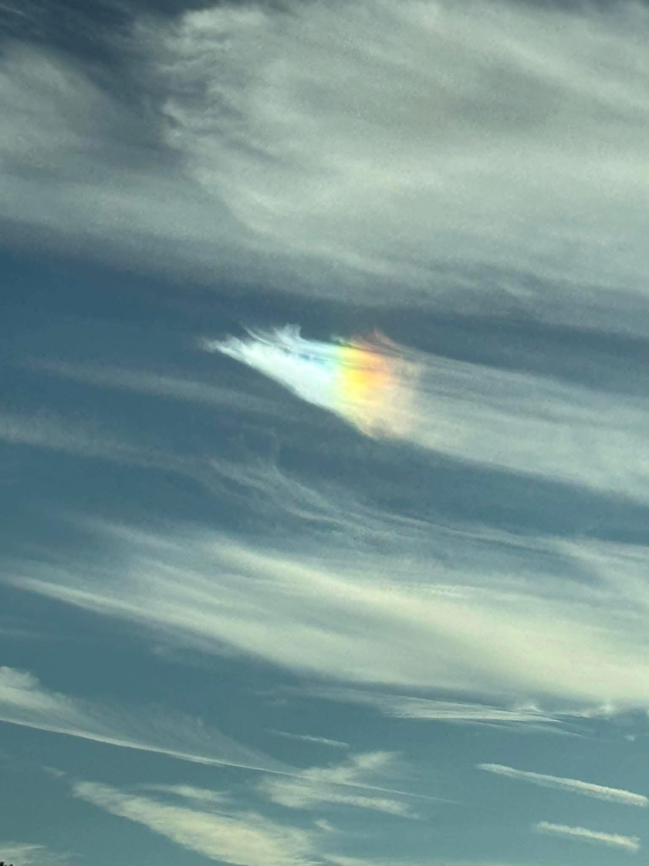
Atmospheric Optics – Cloud Iridescence
Diffraction of sunlight by ice crystals
Fideliz
Schenevus, NY
8/19/25

Slide 20
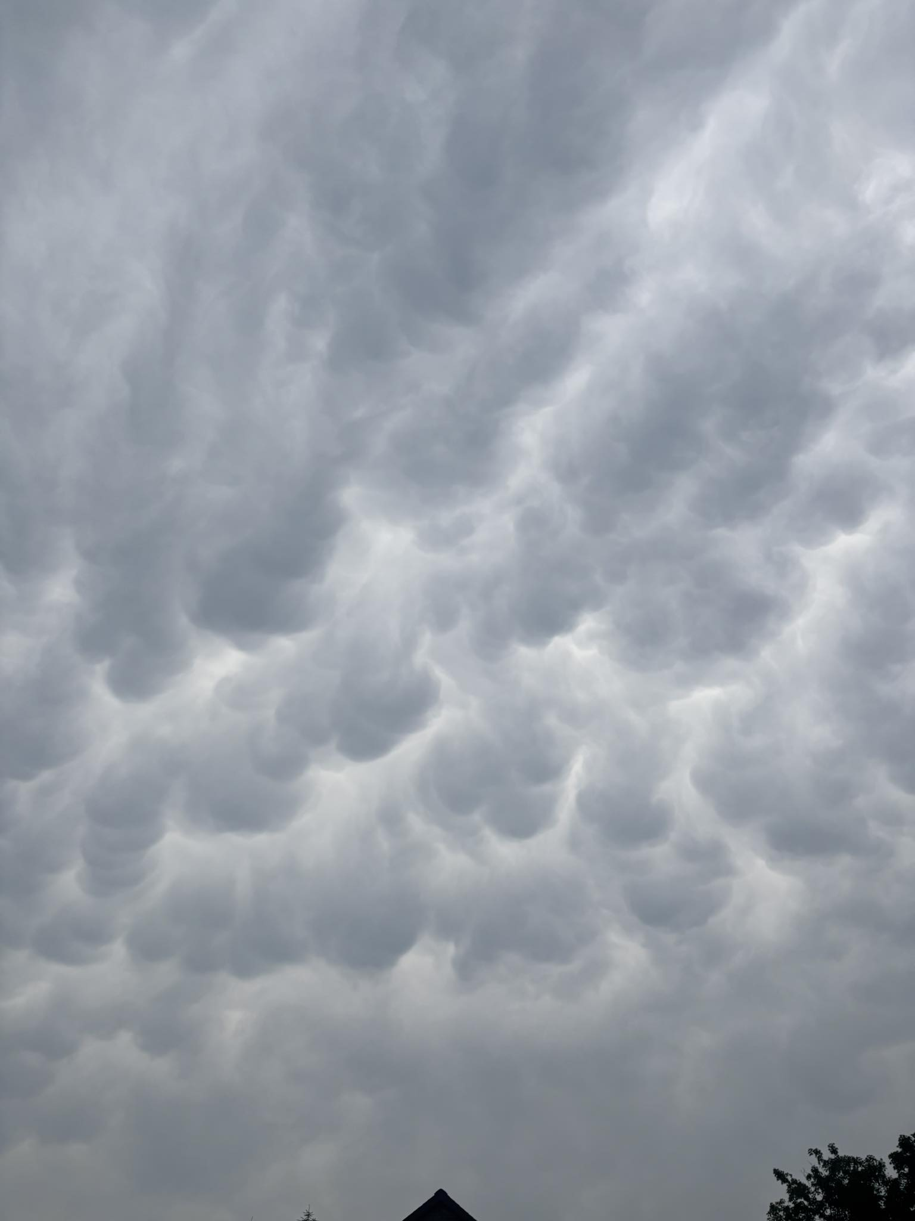
Unusual Clouds – Mammatus
Sinking air in rear of thunderstorm
Meghan Hamlin
7/3/25

Slide 21
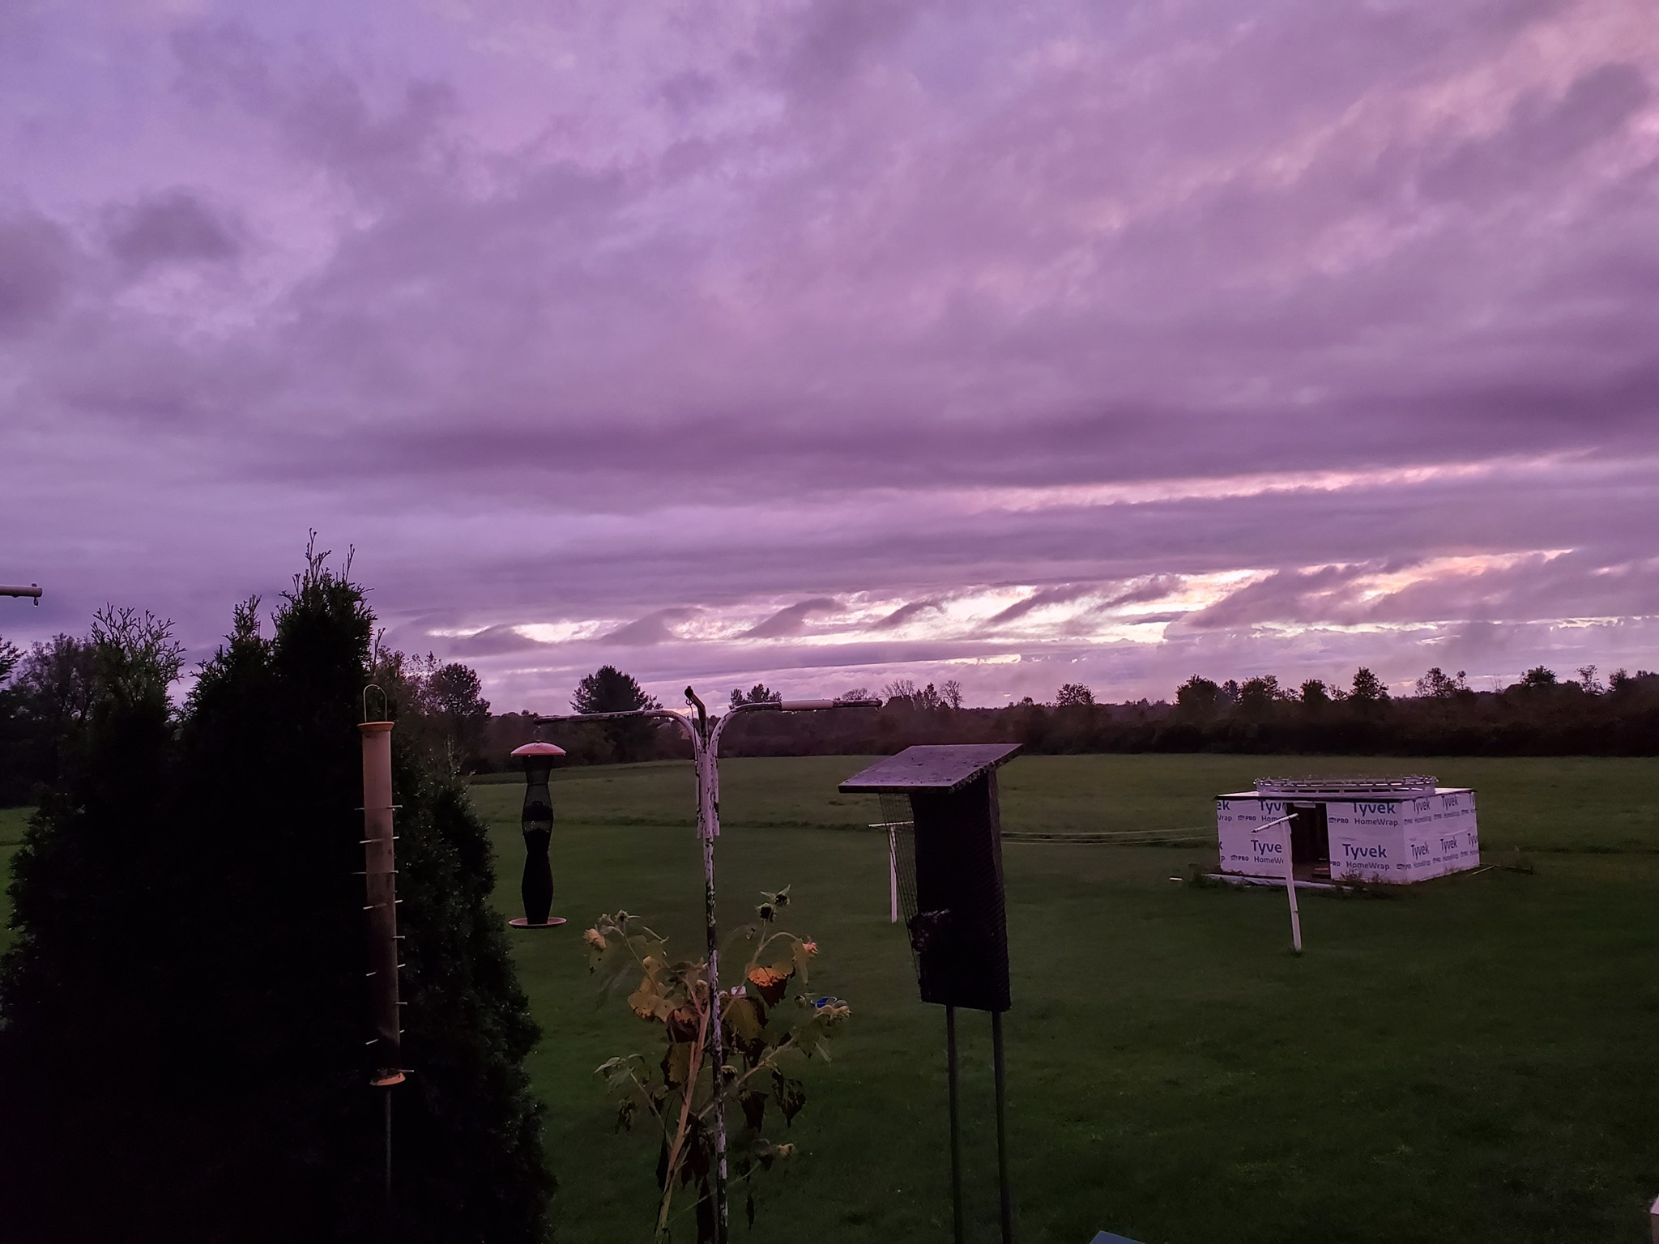
Unusual Clouds – Kelvin-Helmholtz
Two layers of air moving in different directions
(wind shear)
Kathy
Verona Beach, NY
9/23/21

Slide 22
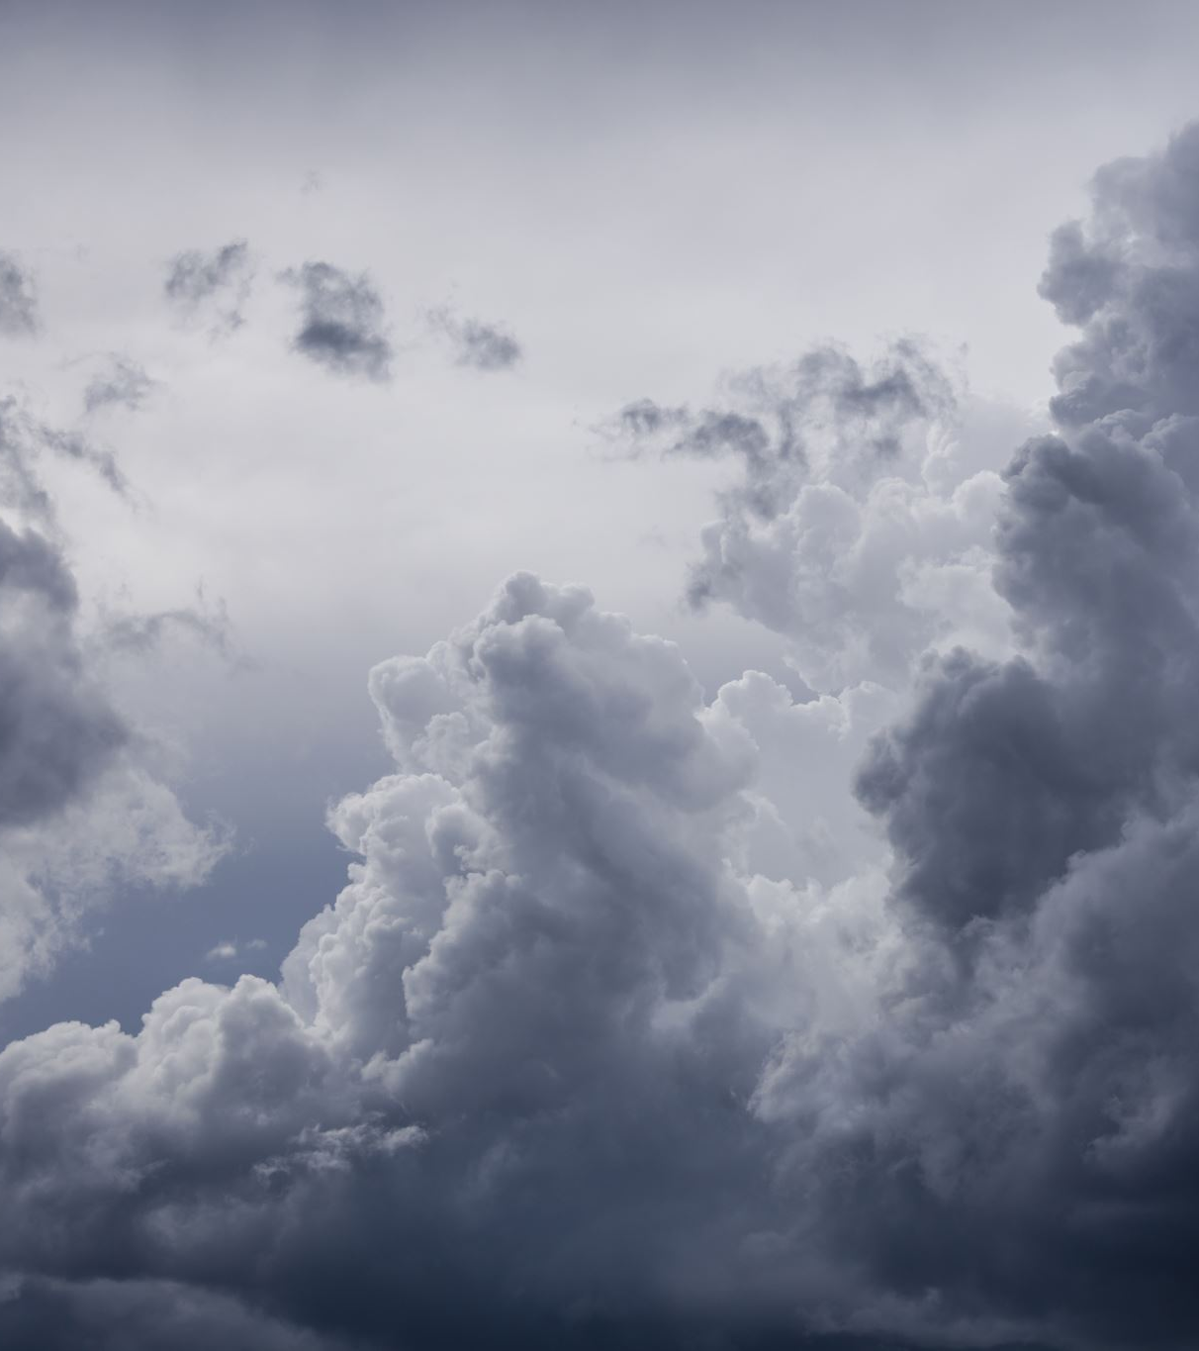
What's Up with Clouds?
Clouds are created simply by
  Cooling saturated air
  Condensation/sublimation
  Cloud condensation nuclei

Slide 23

Height Matters!
The transparency of clouds is related to height
  Low clouds
  Middle clouds
  High clouds
Why?

Slide 24
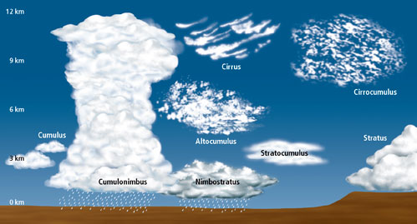
Cloud Types

Slide 25
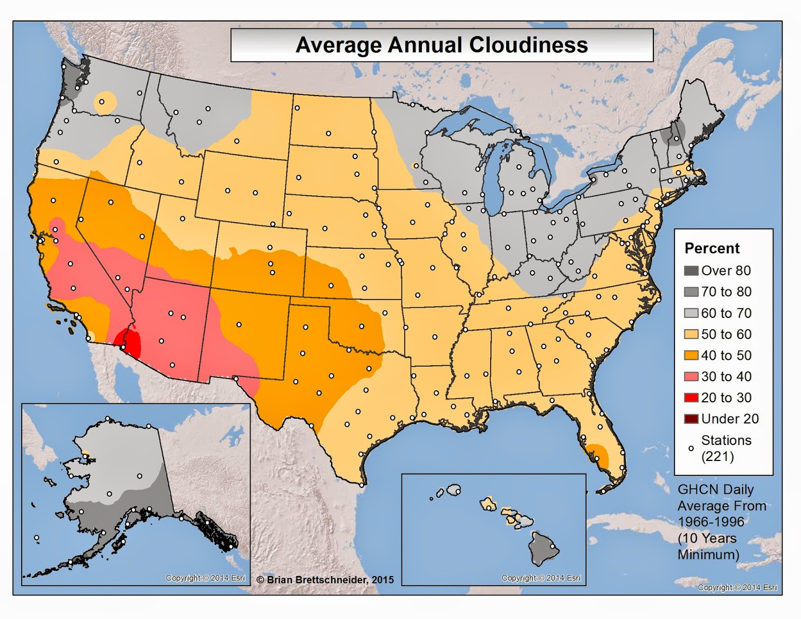

Slide 26
Cloud Cover Climatology
Abundant cloud cover in Northeast due to
  Lake Ontario
  Atlantic Ocean
  The Gulf
  Hudson Bay
Global Circulation Patterns

Slide 27
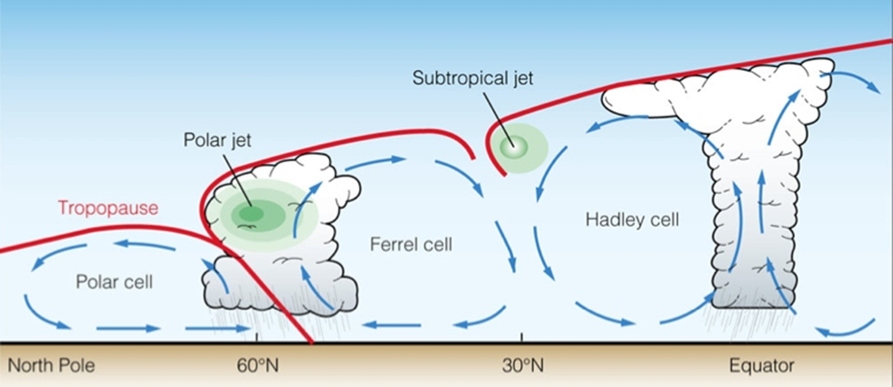
Global Circulation

Slide 28
What is Typically the Cloudiest Month of the Year in CNY?
A) November
B) December
C) January
D) February

Slide 29
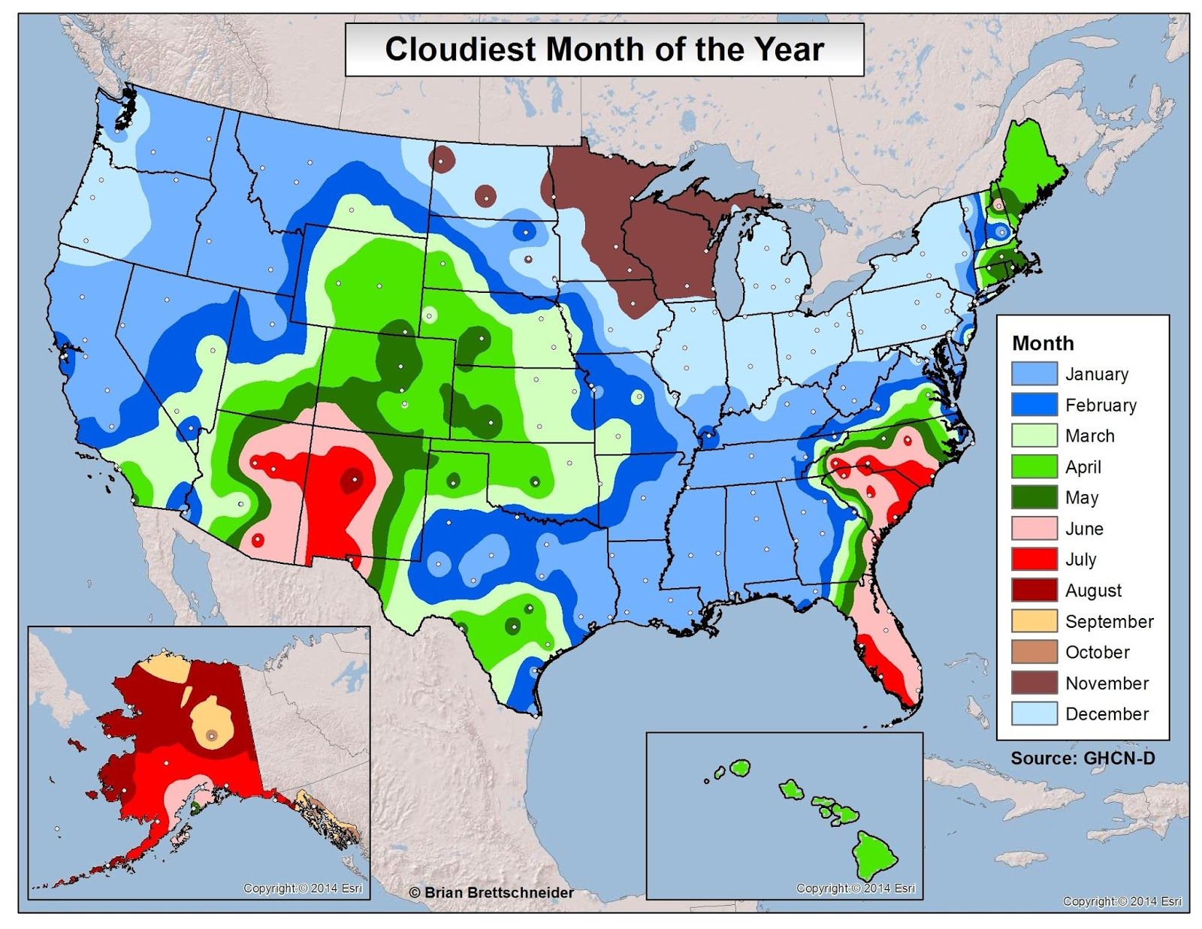

Slide 30
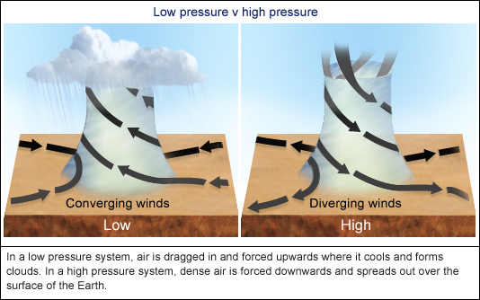
Low vs High Pressure

Slide 31
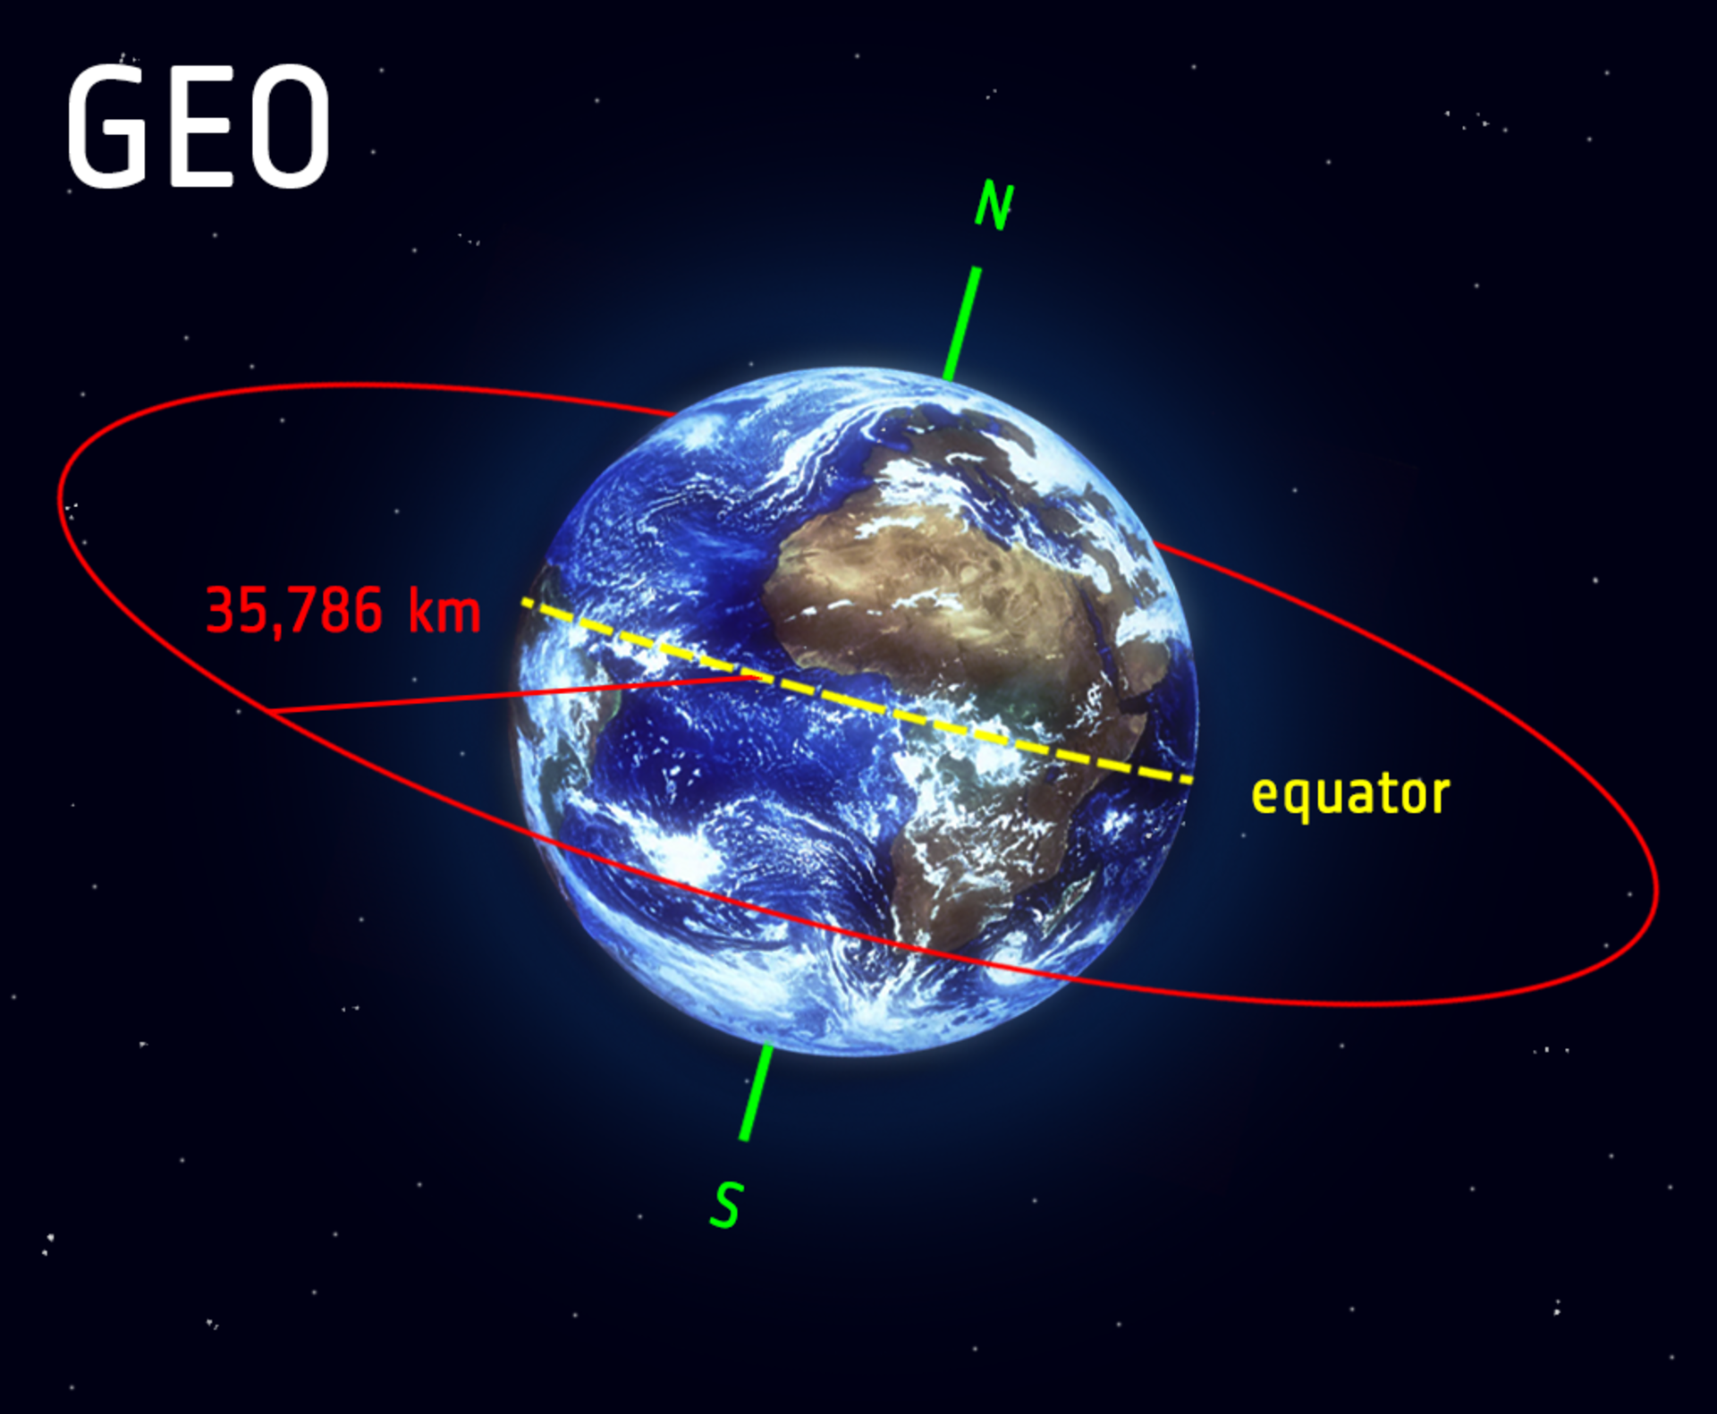
Weather Satellites – Key to Tracking Clouds

Slide 32
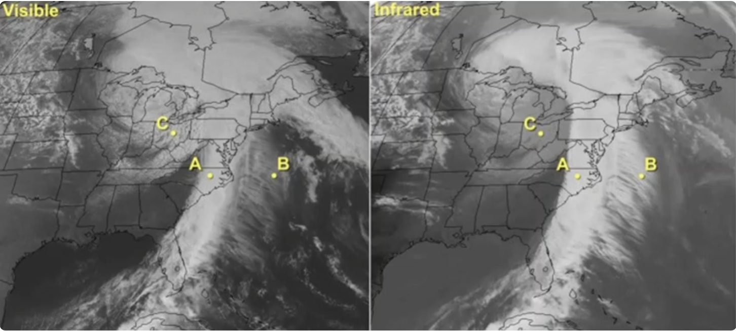
Remote Sensing – Visible & Infrared Imagery

Slide 33
Beware of High Clouds
High clouds – considered "clear weather" in meteorology
Though semi transparent – still impacts star gazing

Slide 34
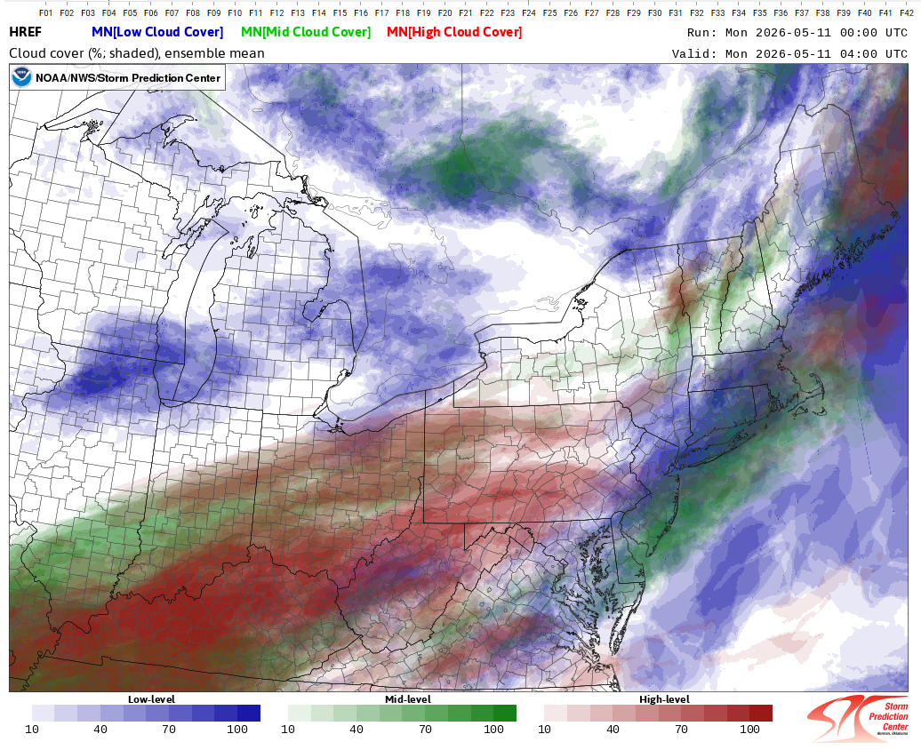
Cloud Cover Prediction – Computer Models

Slide 35
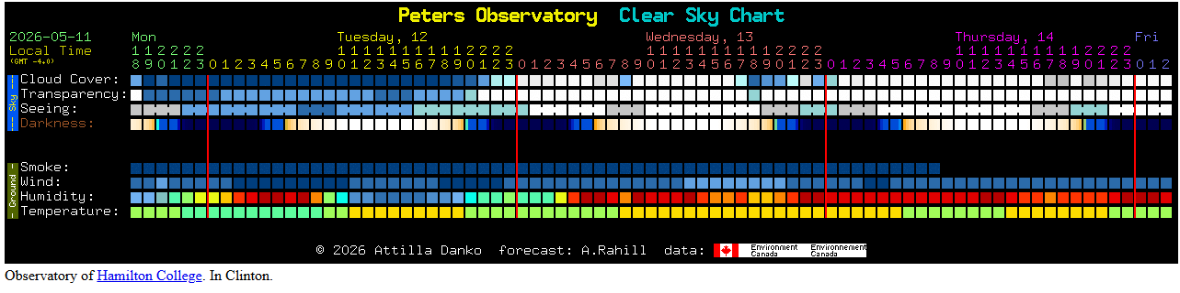
Cloud Cover Forecast Chart

Slide 36
The science behind clear skies
Subsidence – sinking air is key!
  High pressure system
  Cold air advection
  Low Humidity

