Slide 1
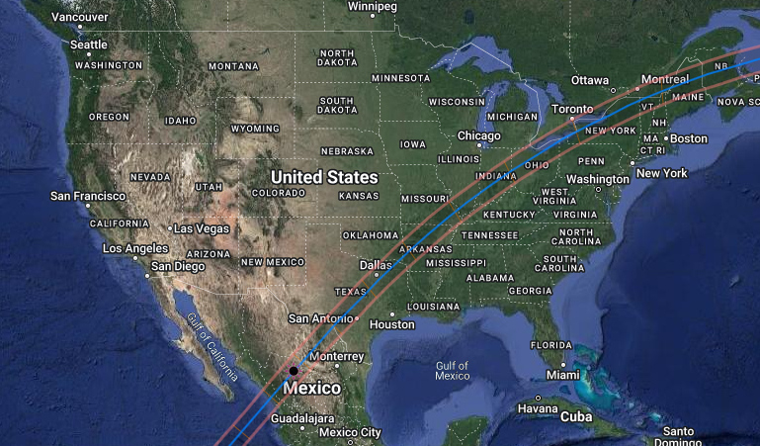
Eclipse 2024: The April 8, 2024 Total Solar Eclipse
by Members of the Mohawk Valley Astronomical Society (MVAS)
March 13, 2024

Slide 2
Did You Know this About Total Solar Eclipses in New York State?
Last Time in New York State: January 24, 1925
Last Time in Utica/Waterville: June 16, 1806
Next Time in New York State: May 1, 2079
Next Time in Utica/Waterville: August 2, 2399

Slide 3
Earth
New Moon
Moon
SUN
93,000,000 miles

Slide 4
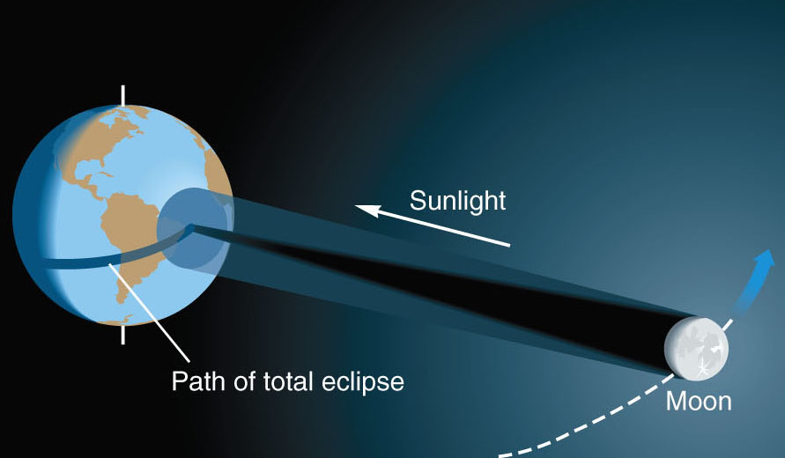
Geometry of a Solar Eclipse

Slide 6
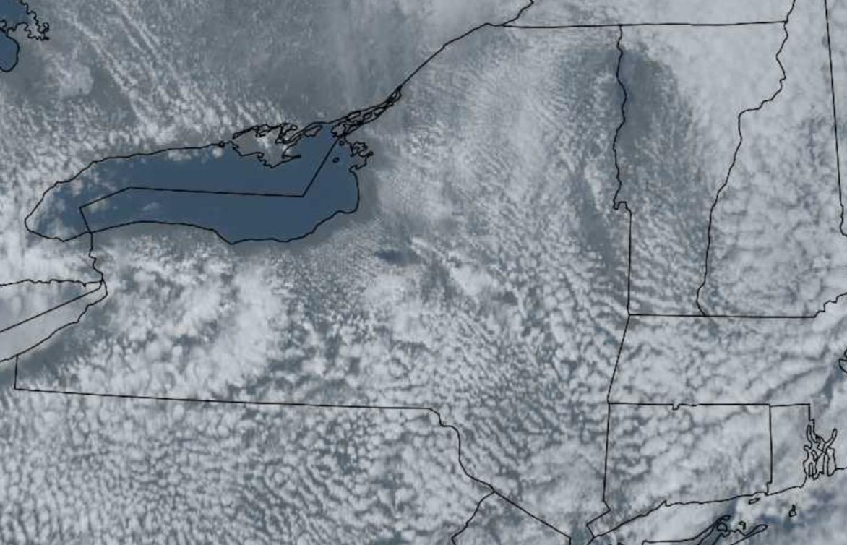
Reverse Lake Effect Example March 29, 2023, Lake Ontario Satellite Image

Slide 7
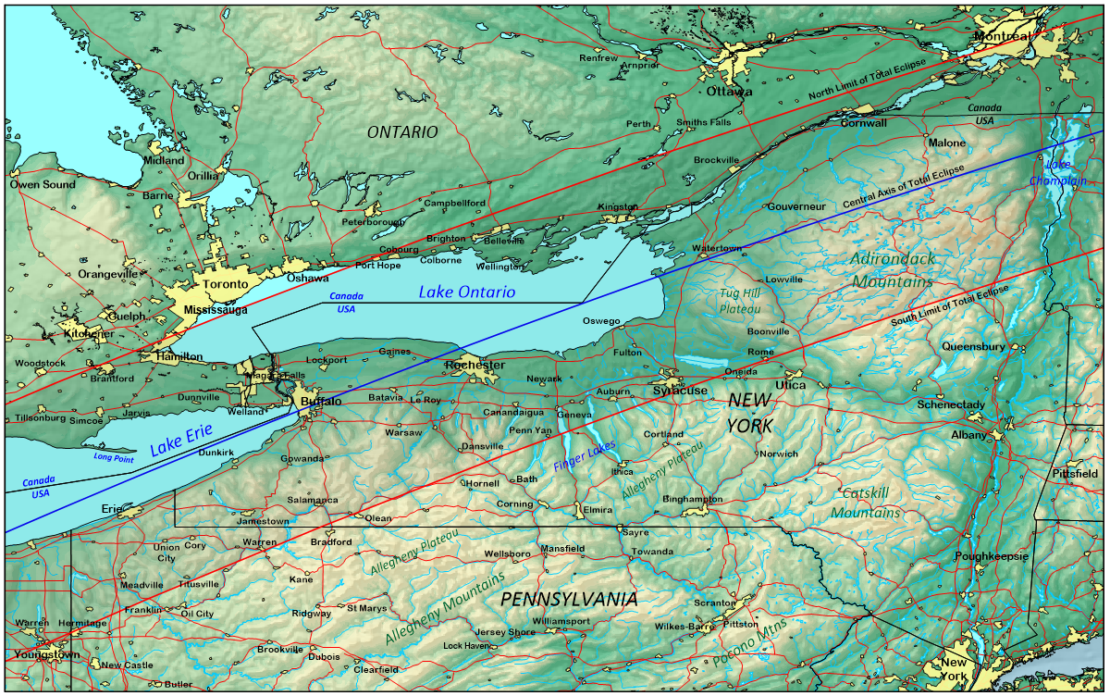

Slide 8
Moon travels W to E

Slide 9
Total Solar Eclipse: Oswego, New York
Partial Phase Begins: 2:08:53 PM
Totality Begins: 3:21:45 PM
Mid-totality: 3:23:30 PM
Totality Ends: 3:25:15 PM
Partial Phase Ends: 4:34:30 PM
Totality Duration: 3 minutes 30 seconds

Slide 10
CHECKLIST OF ECLIPSE EVENTS
Before Totality:
First contact
Moon covers sunspots
Shadows sharpen
Decreasing glare
Changes in animal, plant behavior
Projected crescents
Sky darkens
Temperature drops
Moon’s shadow approaches
Eerie orange sunlight
Shadow bands
Baily’s beads
Diamond ring
Chromosphere
During Totality:
Prominences
Coronal structure
360-degree twilight
Planets and bright stars
After Totality:
Chromosphere
Diamond ring
Baily’s beads
Shadow bands
Eerie orange sunlight
Moon’s shadow departs
Temperature rises
Sky brightens
Projected crescents
Changes in animal, plant behavior
Increasing glare
Shadows soften
Moon uncovers sunspots
Last contact

Slide 11
How to Find the Sun During Partial Phases
Sit in a comfortable chair with sunscreen applied to your face.
Put on the solar filter glasses.
Everything will look BLACK.
Look toward the Sun.
Move head around to find the Sun.
Before eclipse day: PRACTICE finding the sun using your solar filters.
Binoculars must have solar filters on the FRONT of the lenses.

Slide 12
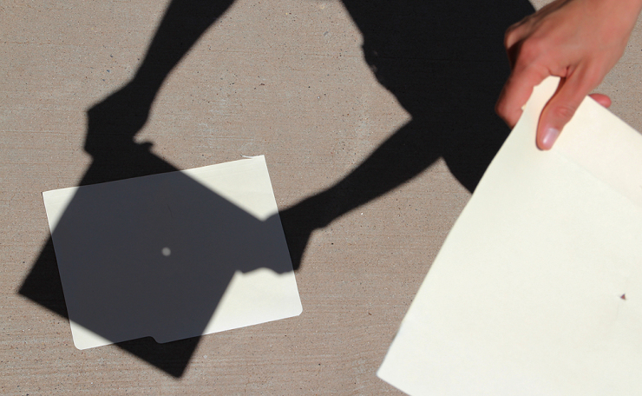
Pin-hole Camera Viewer
Small Hole

Slide 13
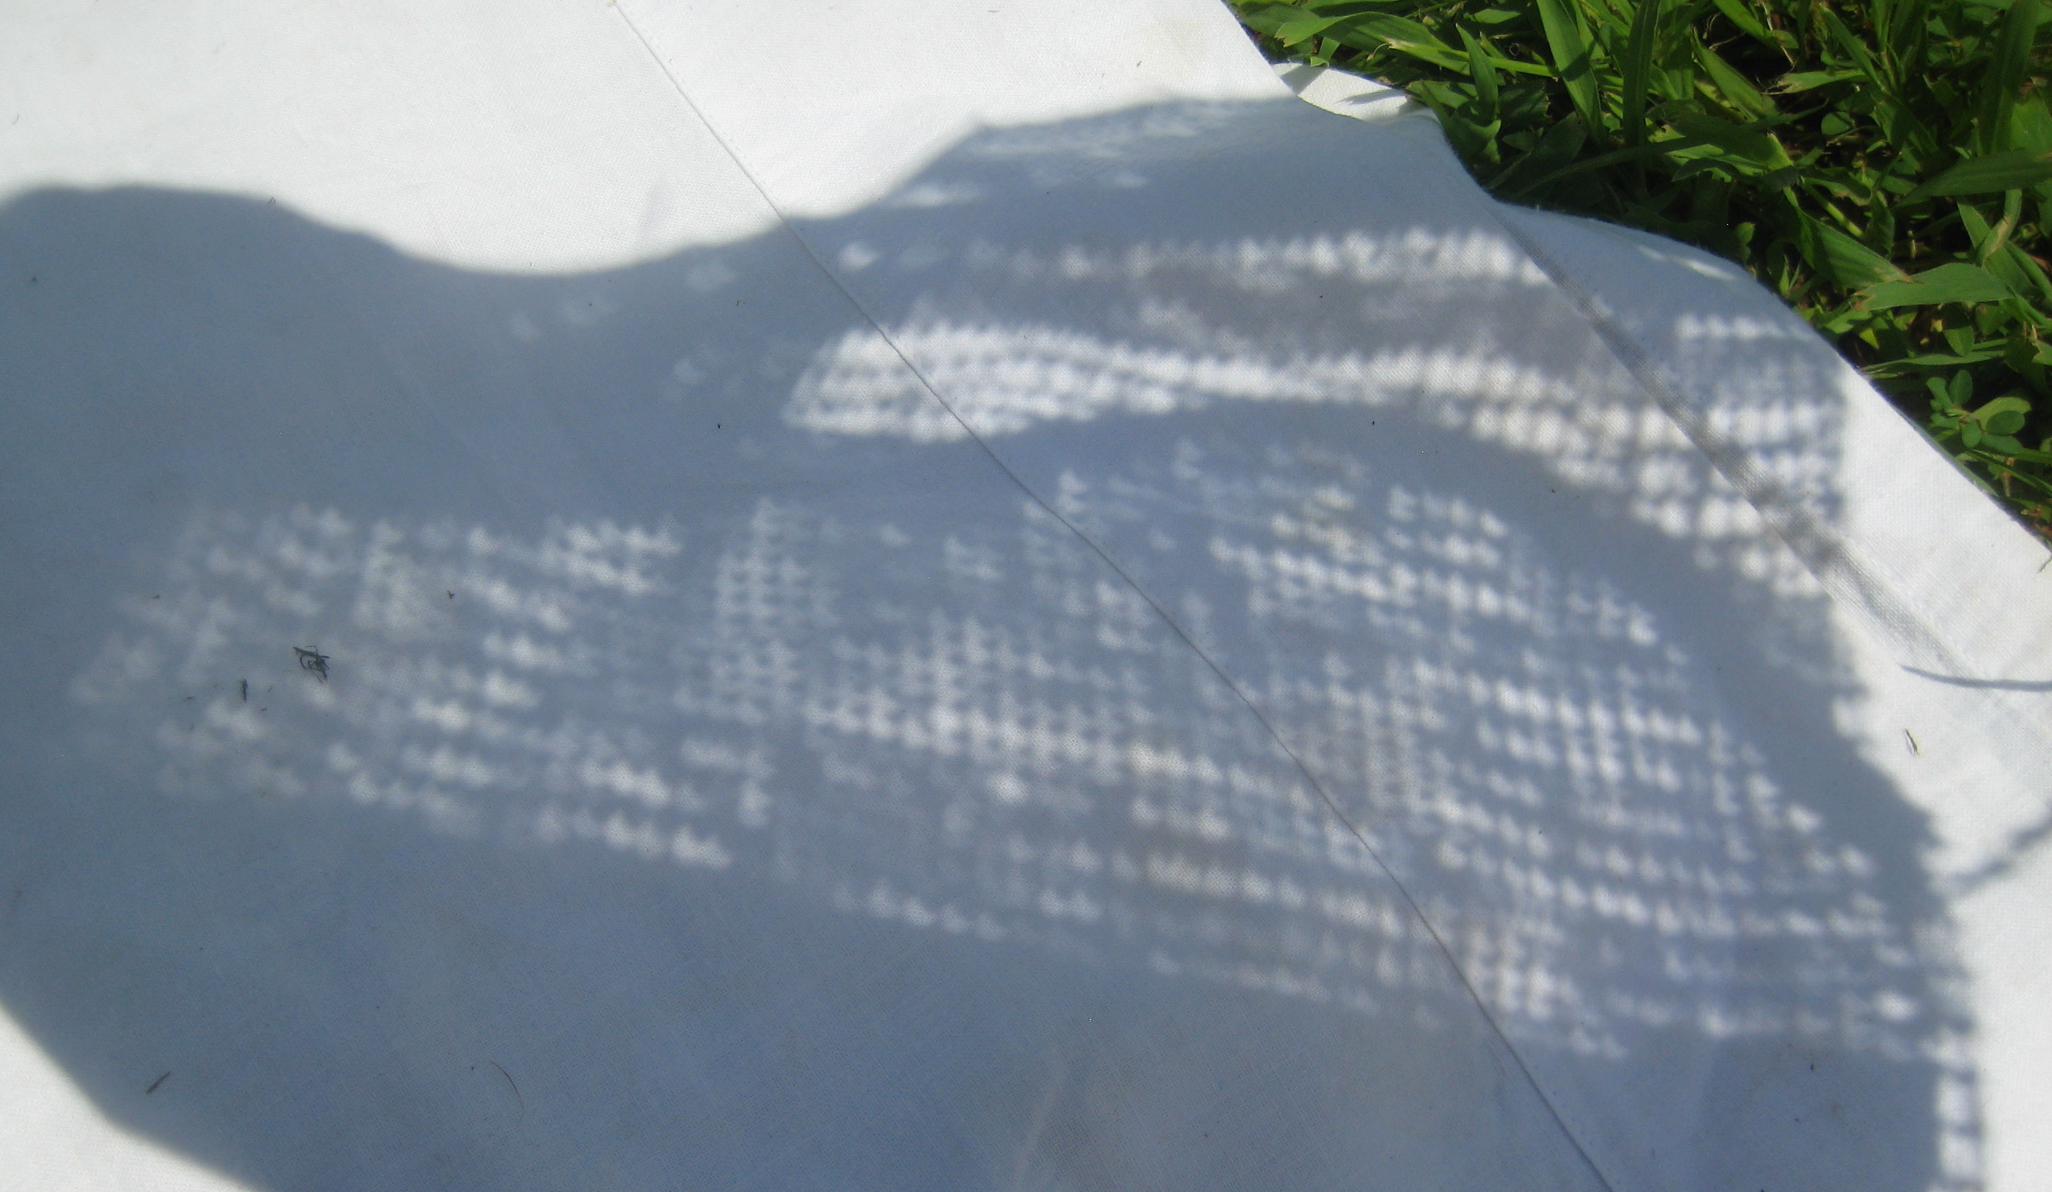
Spaghetti strainer, kitchen grater, potato sack, crossed fingers, loose weave fabric like burlap

Slide 14
What to Do if You Need to be Mobile
Devise a Plan B ahead of time.
Have a full tank of gas, food, water, chairs etc. in the car.
Get up early on eclipse day - keep track of weather conditions.
Consult weather reports such as …
Weather Underground: www.wunderground.com
Weather Street: www.weatherstreet.com
Set out before 50% eclipsed = ~ 40 minutes travel time
BE CAREFUL. Safety FIRST. Traffic will be VERY HEAVY!

Slide 15
Eclipse Day: April 8, 2024
It probably WILL be cold on eclipse day.
Dress warm. You will be outdoors for several hours.
Wear warm and appropriate footwear such as warm hiking boots.
Bring a cooler with food and water. You may be at a location for a while.
Make sure you know how to use your solar filter glasses and help those who don’t, particularly children!
If you are in the path of totality, keep track of the time during the total eclipse so you know when to put eye protection back on.

Slide 16
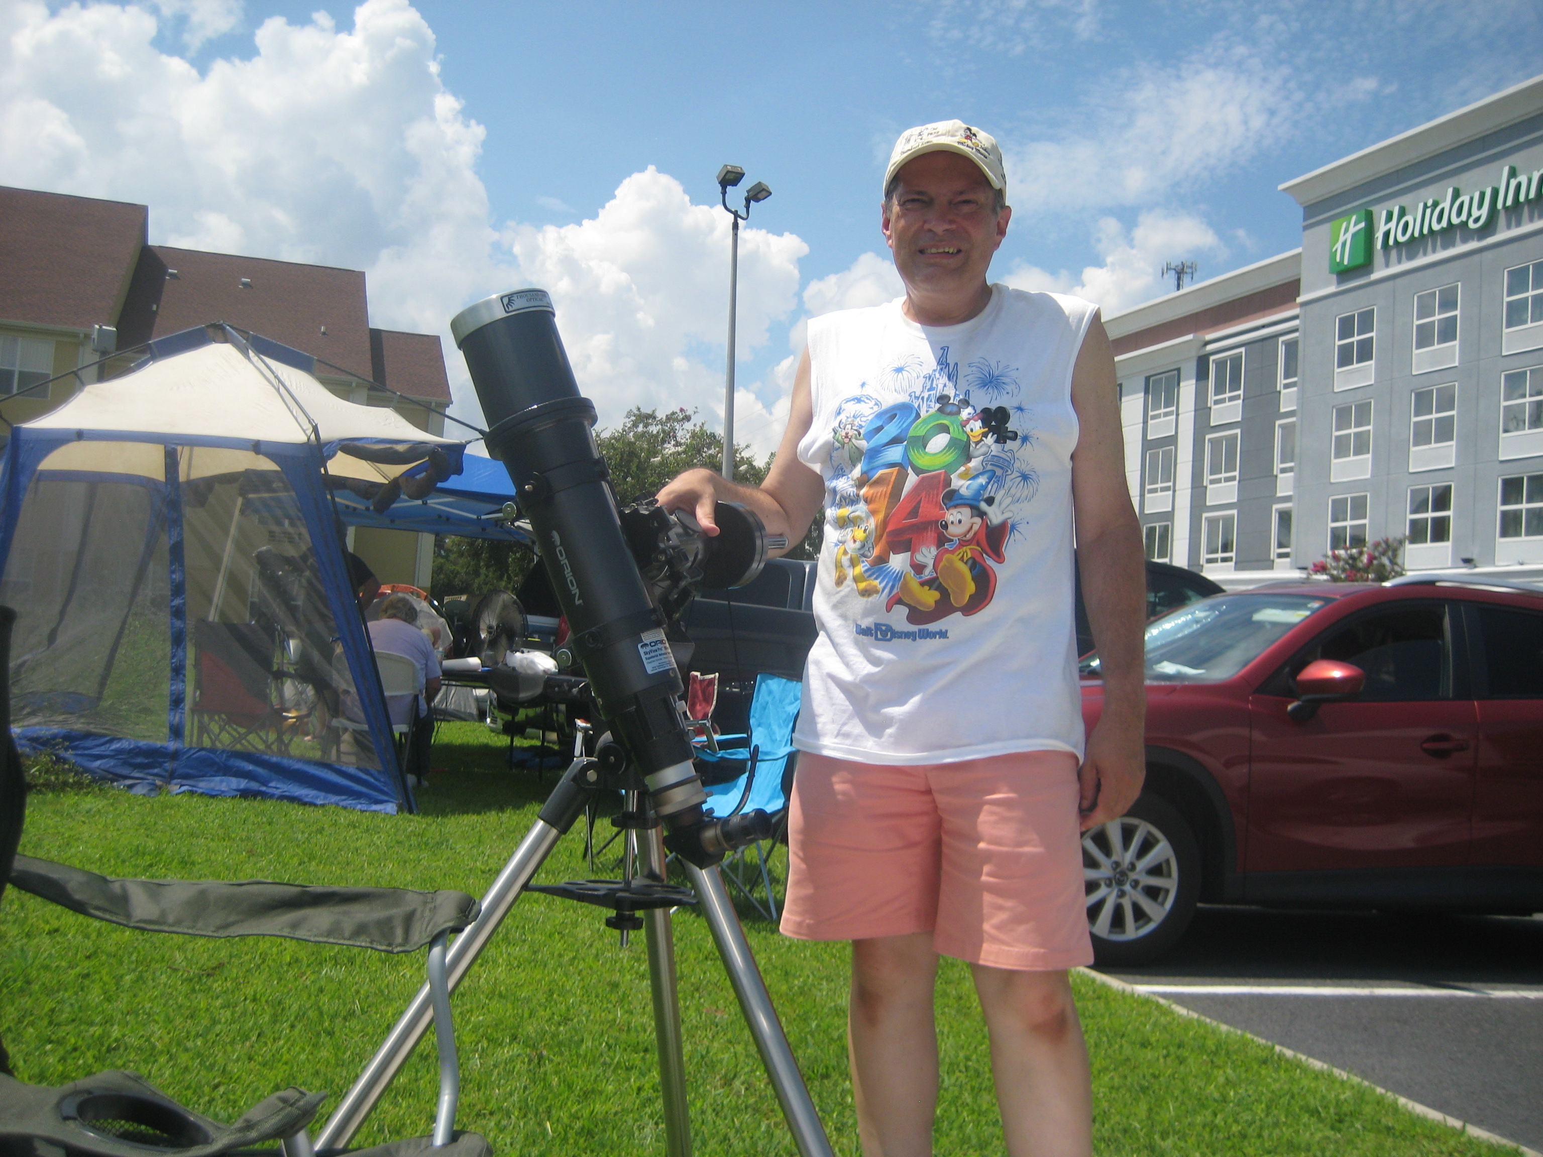

Slide 17
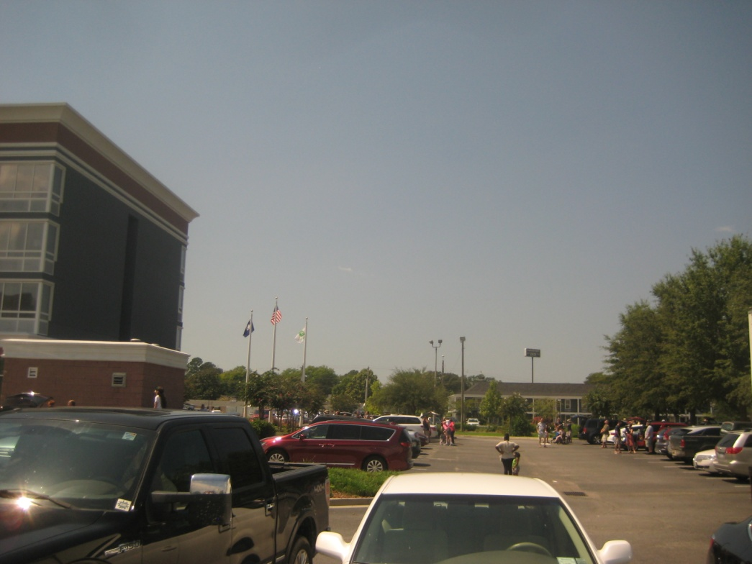
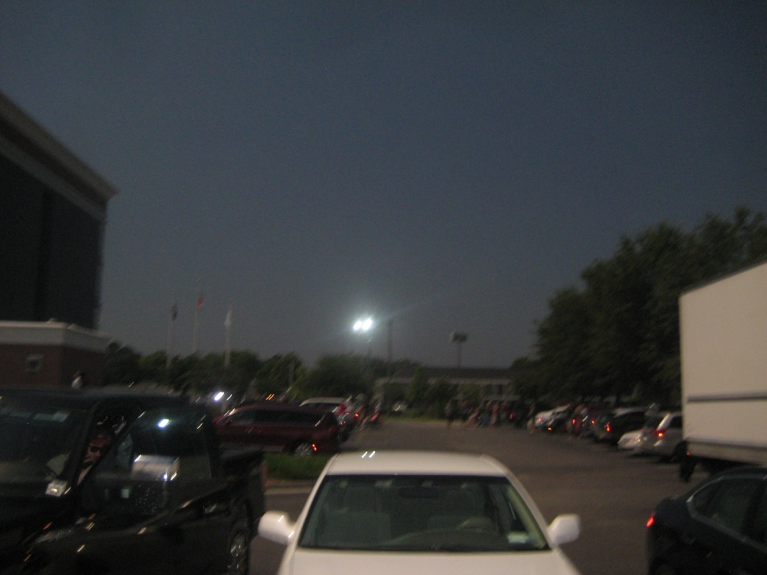
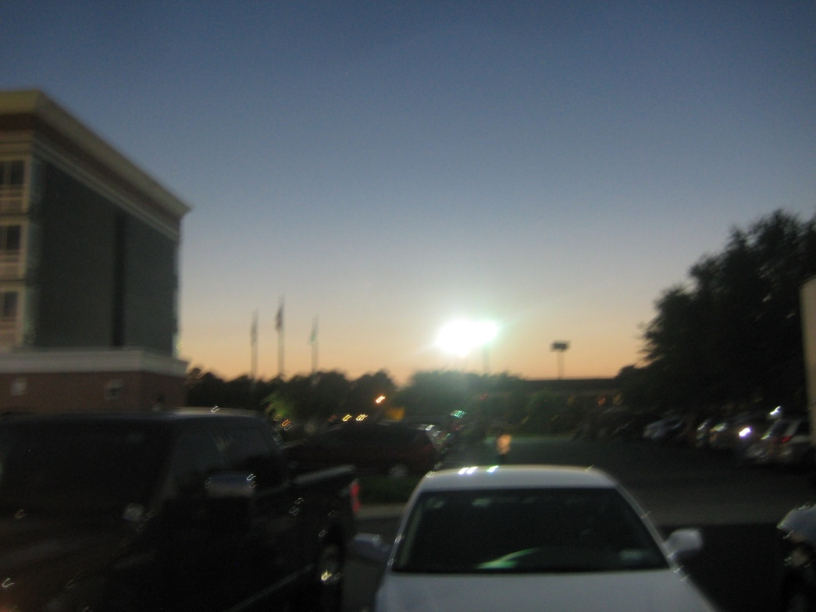
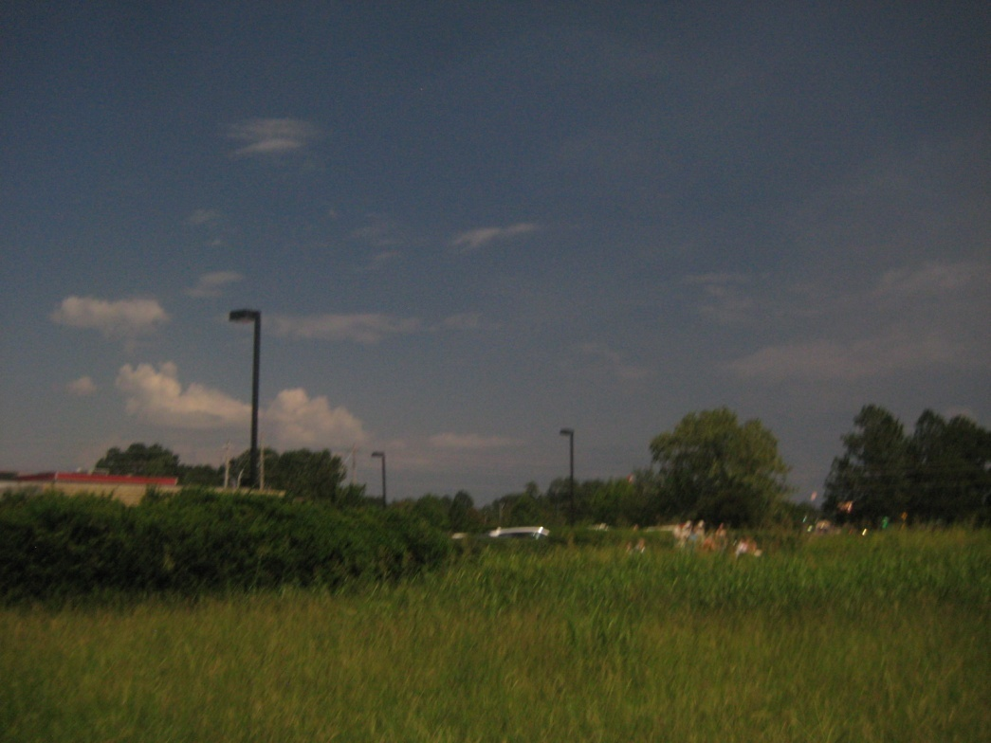

Slide 18
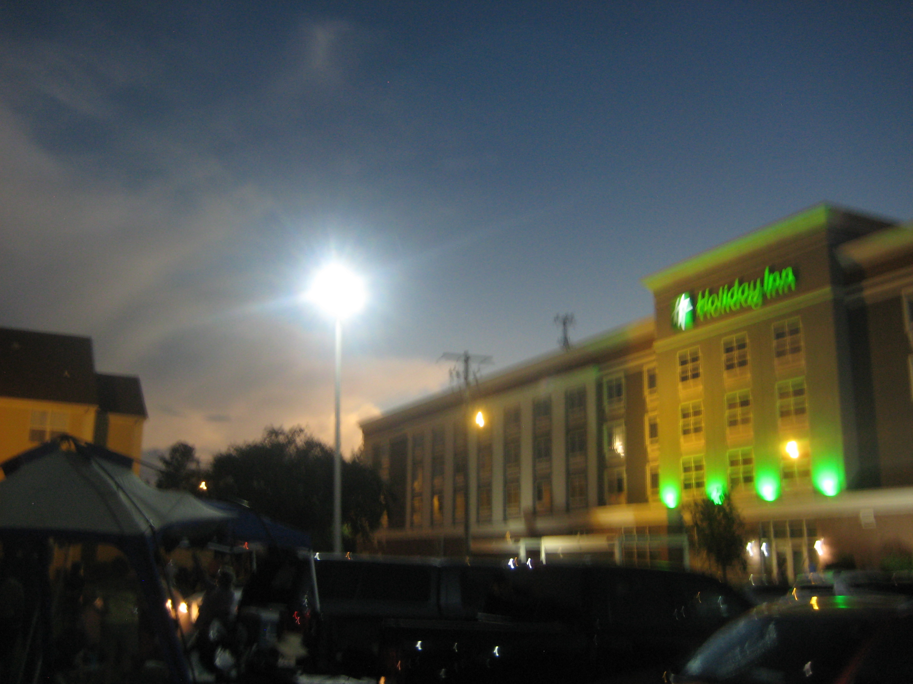

Slide 19
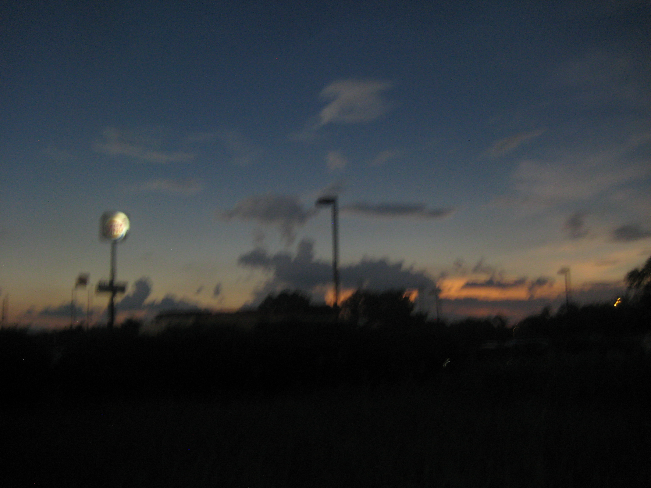

Slide 20
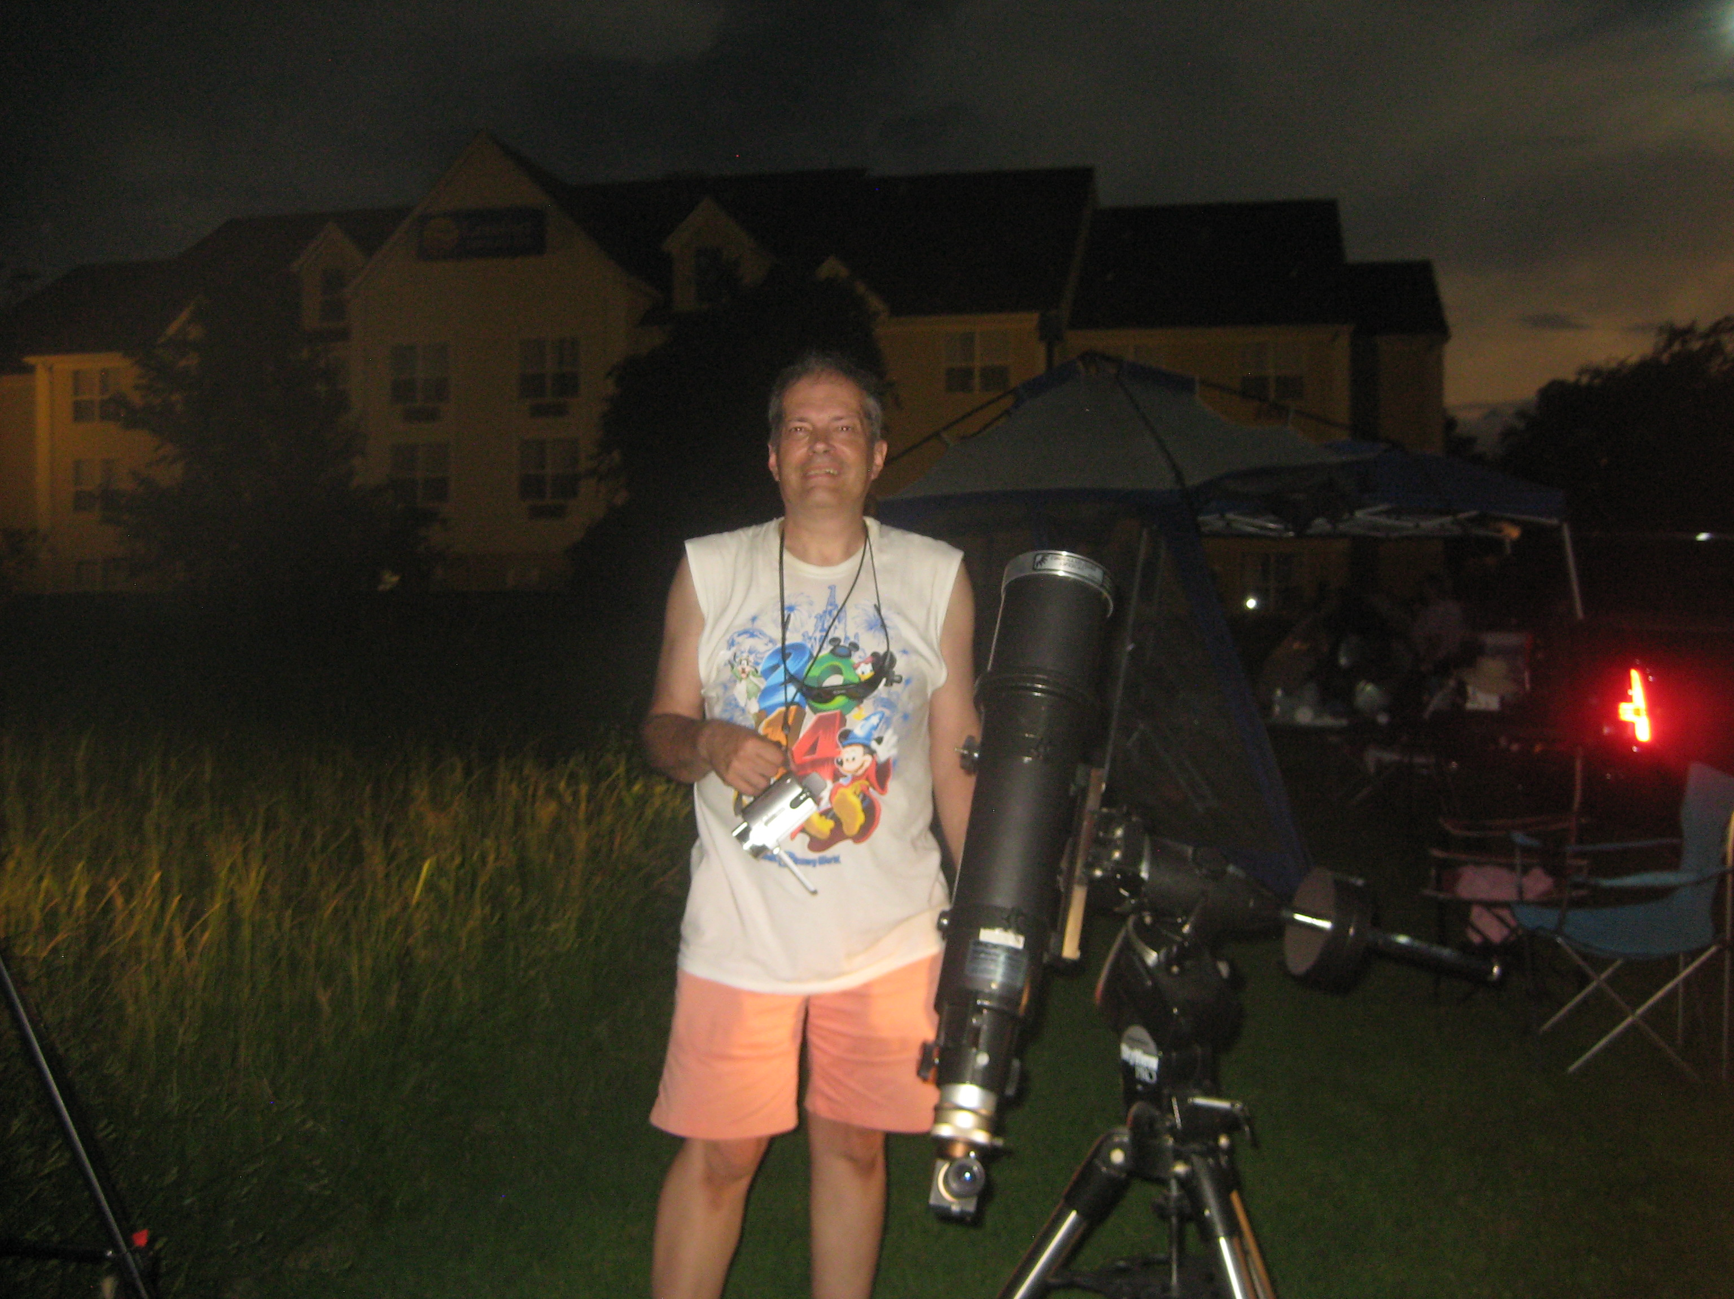

Slide 21
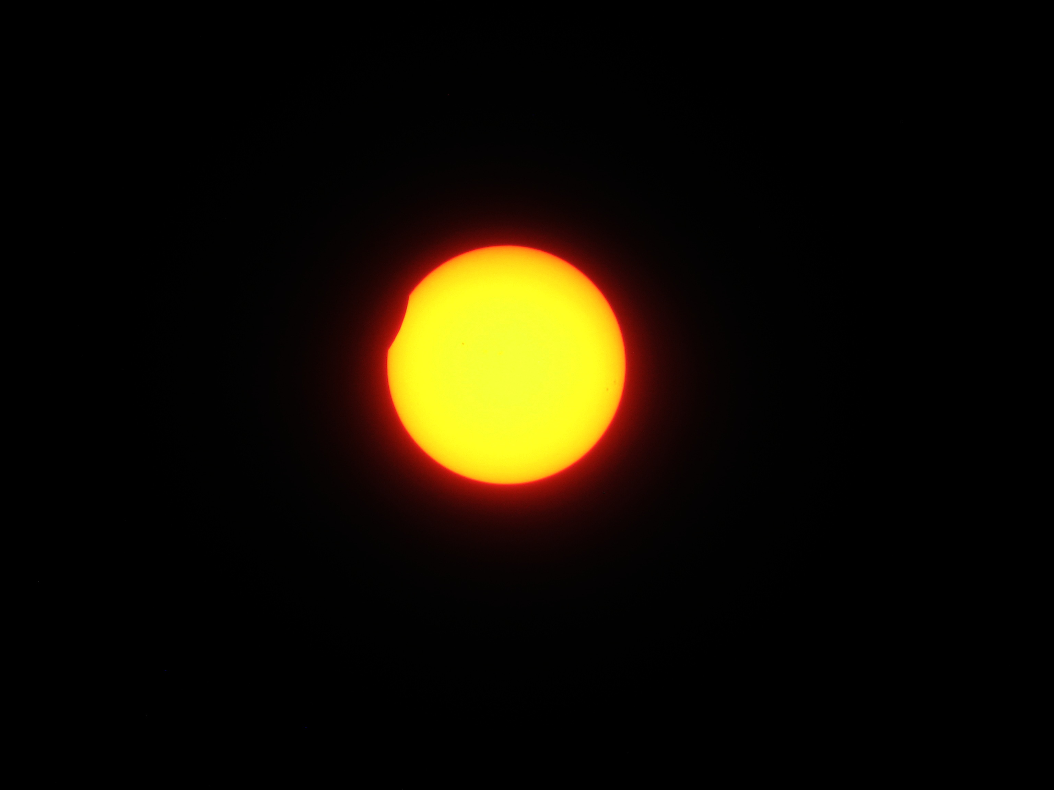

Slide 22
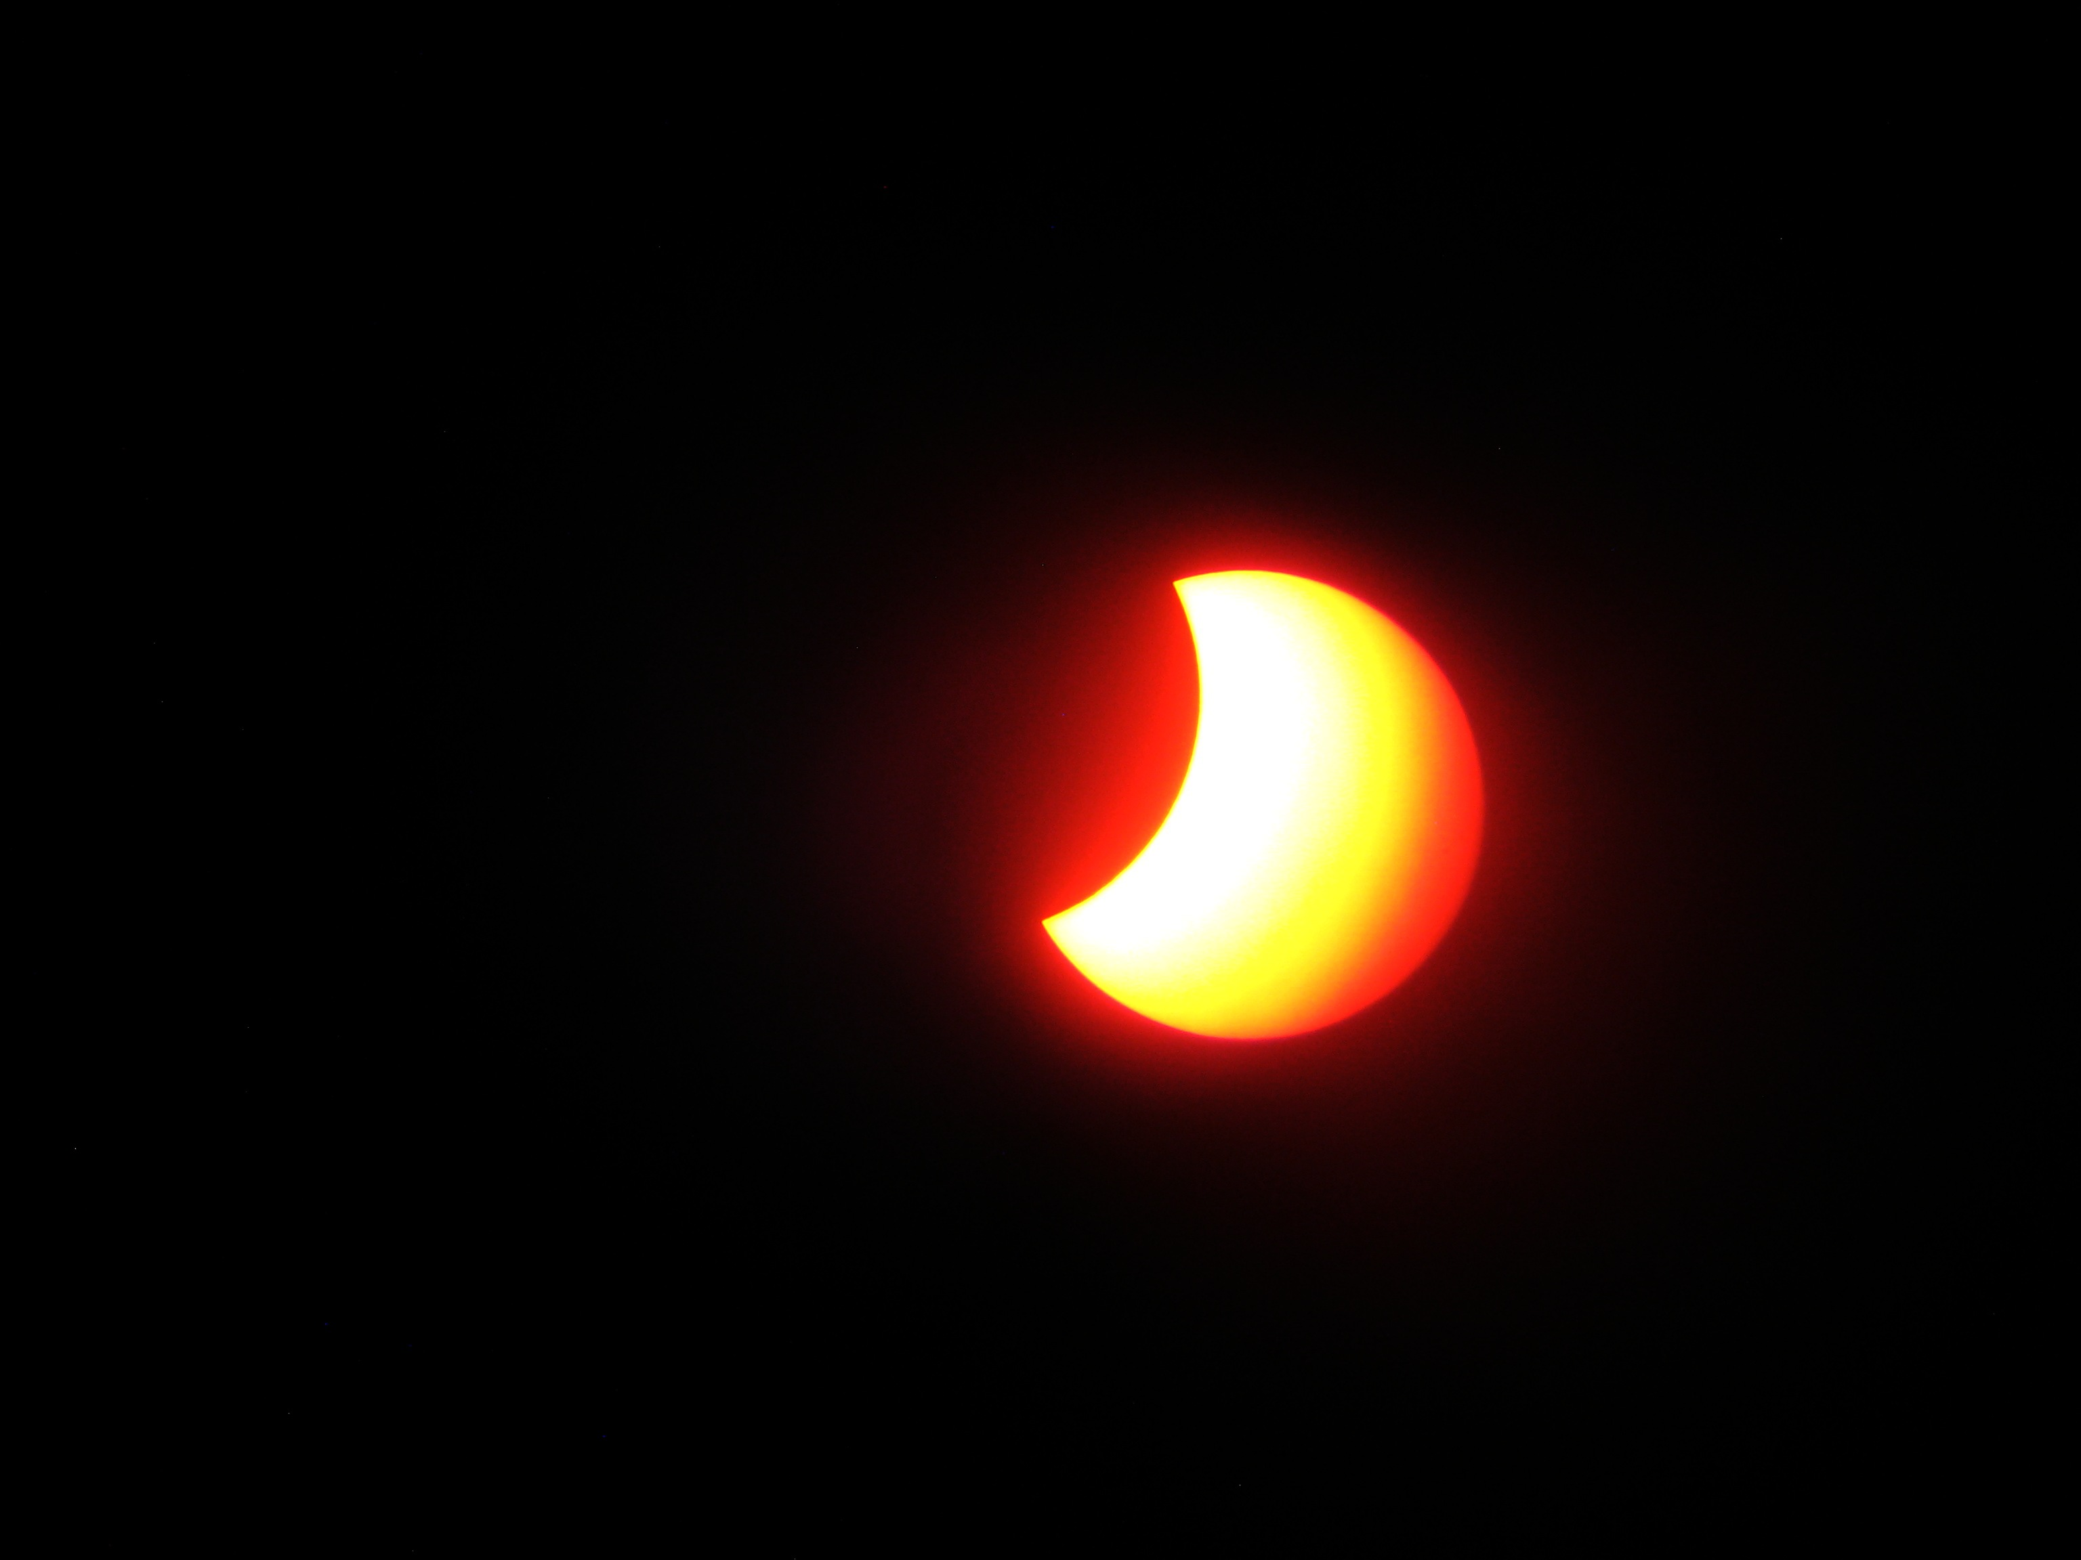

Slide 23
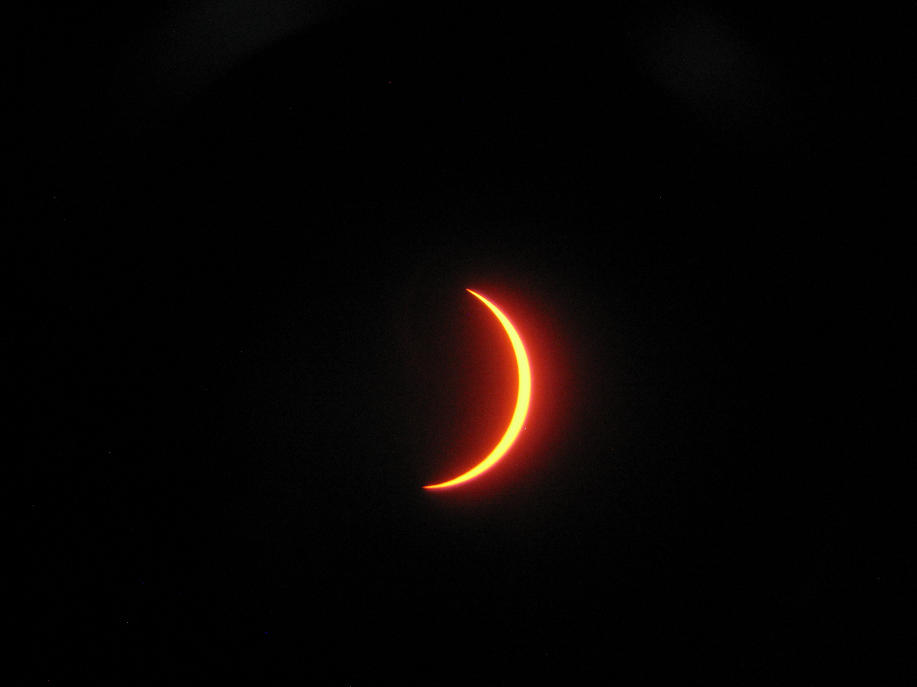

Slide 24
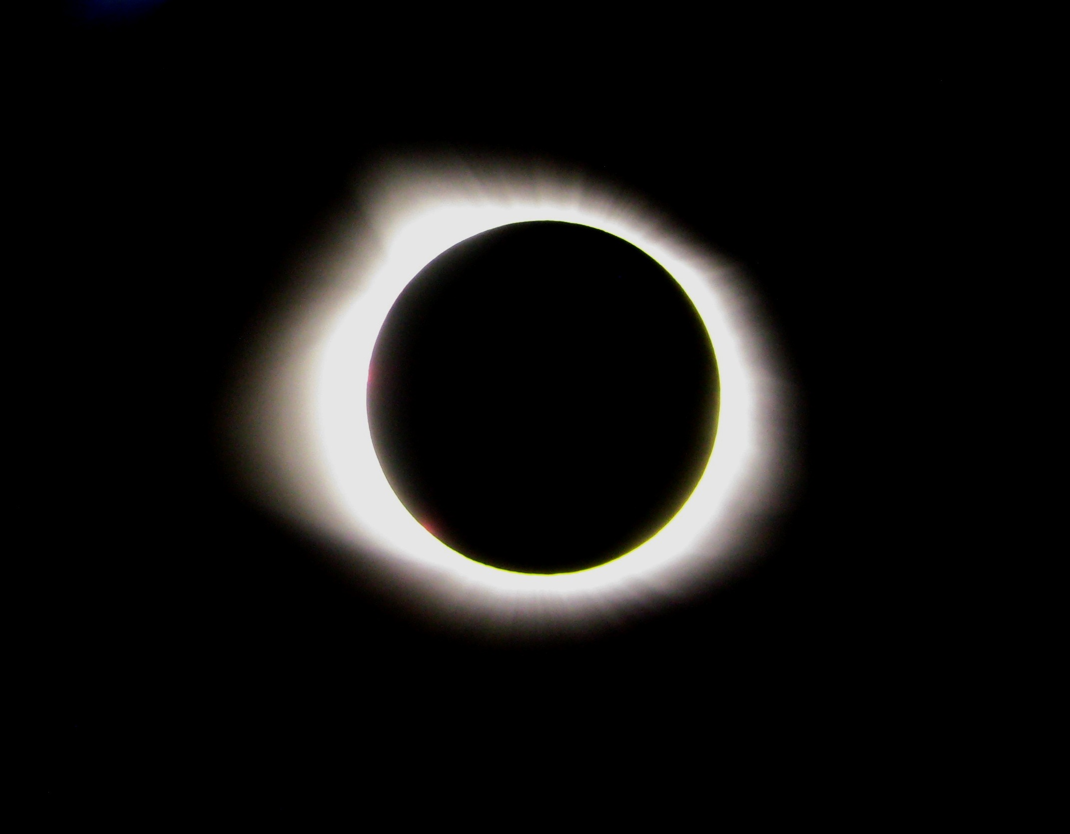

Slide 25
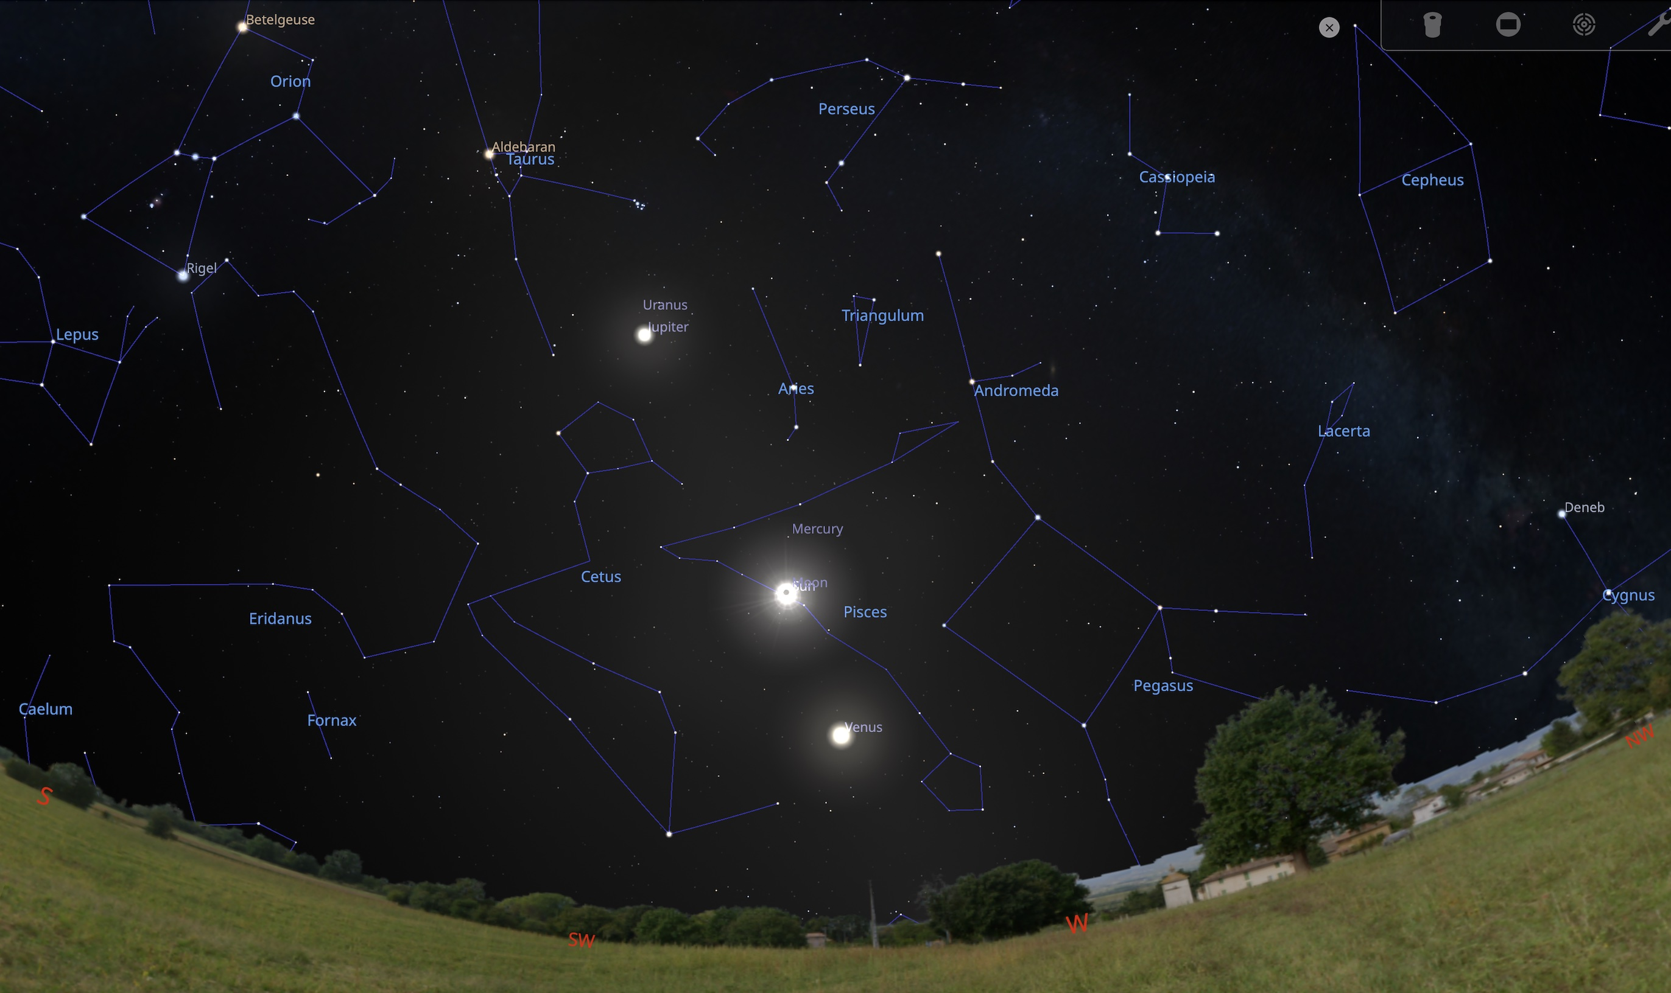
Comet Pons-Brooks
Notes:
Venus = 21 deg Sun = 35 deg Jupiter =. 59 deg Comet Pons Brooks - slightly upper right of Jupiter

Slide 26
Questions?

